Slide 1
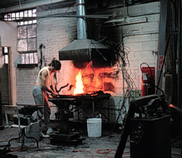
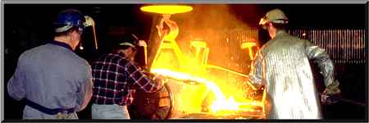
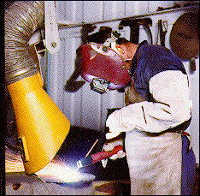
ART SAFETY
Presented by
the ECU Office of Environmental
Health and Safety

Slide 2
ART SAFETY
Common misconception that Art is non-hazardous occupation
Encounter same hazards as found in industry
Mindset may place personnel at greater risk

Slide 3
PROGRAM OUTLINE
Regulatory Review
Types of Hazards
Effects of Exposure
Routes of Exposure
Hazard Identification (SDS & Labels)
Hazardous Materials Storage
Protection from Hazards
Common Issues
Questions

Slide 4
OSHA REGULATIONS AND EPA INITIATIVE
Colleges and Universities are required to comply with all applicable safety and environmental requirements like industry
OSHA standards deal primarily with employee safety (www.osha.gov)
EPA regulations deal primarily with protection of the environment (www.epa.gov)
Tort liability addresses non-employee safety

Slide 5
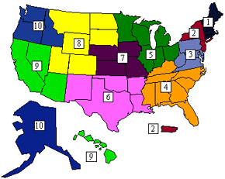
OSHA REGULATIONS AND EPA INTIATIVE
Subject to inspection by both agencies
Subject to federal and state agency inspection
EPA has already stepped up enforcement actions in Regions 1, 2 and 3
University of Hawaii fined $1.8 million
Boston College and Stanford fined $1 million
Yale received a $300,000 fine
Common deficiencies
Provisions for fine and
imprisonment of individuals

Slide 6
ART SAFETY
Know the hazards and how to protect yourself (Hazard Communication)
Must be incorporated into all activities
If activity cannot be done safely then it should not be done at all
Must become part of the curriculum
Preparation for the “REAL WORLD”
Reflection on Institution and Faculty

Slide 7
TYPES OF HAZARDS
CHEMICAL – paints, dyes, glazes, inks, solvents, clay, metals
PHYSICAL - heat, lifting, machinery, tools, noise
ERGONOMIC – work stations, tools
RADIATION – lasers, welding, kilns
BIOLOGICAL – plant products, animal skins, bone, hair, blood borne pathogens

Slide 8
EFFECTS OF EXPOSURE
ACUTE - direct threat that shows up almost immediately after exposure such as burns from contact with a corrosive chemical.
CHRONIC - result of repeated exposure that occurs over months or years and includes cancer and some allergic reactions.

Slide 9
RISK FACTORS
Toxicity
Level, Duration and Frequency of Exposure (minimize exposures)
High Risk Groups (pregnant women, children, smokers)
Personal Susceptibility

Slide 10
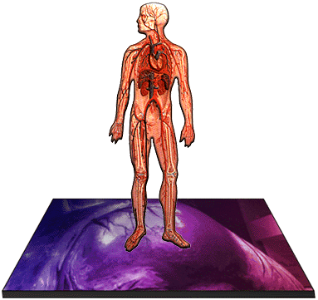
ROUTES OF EXPOSURE
INHALATION
ABSORPTION
INGESTION
INJECTION

Slide 11
ROUTES OF EXPOSURE
INHALATION:
Primary Route of Entry
Airborne contaminants such as gases, vapors and particulate matter that enter directly into lungs
Respiratory protection or specialized exhaust may be necessary.

Slide 12
ROUTES OF EXPOSURE
ABSORPTION:
Can occur very quickly through cut or abraded skin
Many compounds can be absorbed through intact skin (methyl mercury incident)
Absorption through eyes are of great concern due to their sensitivity and splash hazards
Barrier protection (such as gloves) and personal hygiene are the primary control measures.

Slide 13
ROUTES OF EXPOSURE
INGESTION:
Includes direct tasting of chemicals.
More often occurs when contaminated items are placed in the mouth.
Purpose for banning food, drink, tobacco, and cosmetics in the studio/work areas.
Personal hygiene, labeling and housekeeping are very important to ingestion hazard control.

Slide 14
ROUTES OF EXPOSURE
INJECTION:
Places contaminants in direct contact with the blood stream. These cuts are difficult to clean.
Needle sticks.
Deep cuts involving contaminated glass or plastic shards or similar sharp items.

Slide 15
RESPIRATORY PROTECTION
Use approved through EH&S.
Must be part of ECU Respiratory Protection Program.
Medical Clearance
Training
Annual Fit Test

Slide 16
VENTILATION
Do Not Block Air Supply or Return Grills.
Do Not Remove Ceiling Tiles.
If missing, put in a work order.
Use Toxic or Odorous Chemicals in Fume Hoods.
Canopy Hoods are for Heat Removal Only.
Local Exhaust for Point Source Control.

Slide 17
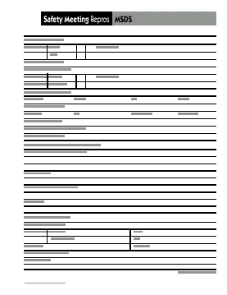
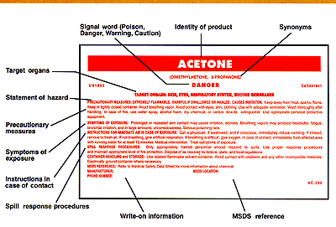
HAZARD IDENTIFICATION
INVENTORY
SDS’s (Safety Data Sheets)
LABELS

Slide 18
MATERIALS INVENTORY (CHEMICALS)
Identifies materials you have.
Chemical inventory list are required for each studio/shop area.
Identifies location and quantity of each.
Do you need all the materials you have on hand?
Minimize inventory.

Slide 19
HAZARD IDENTIFICATION SDS’s
Chemical information sheets that include chemical ID, physical characteristics, hazardous ingredients, health hazards, handling precautions, first aid, reactivity data and control procedures.
Must have a sheet for every hazardous chemical on site and must be accessible to every employee during the hours the employee is allowed to work.

Slide 20
HAZARD IDENTIFICATION LABELS
All containers must be properly labeled.
Labels must include:
Identity of the material.
Hazard warnings.
Responsible individual.
Identity of material must be the complete name as it appears on the original label or SDS.
Abbreviations and/or chemical formulas must not be used as primary identification.

Slide 21
HAZARD IDENTIFICATION LABELS
Appropriate hazard warnings include DOT hazard classes, NFPA Hazard Diamond, or a descriptive statement of the hazards
Whichever method is employed, it must be used consistently throughout the labs and all workers must be familiar with the method

Slide 22
EXAMPLES OF DOT LABELS

Slide 23
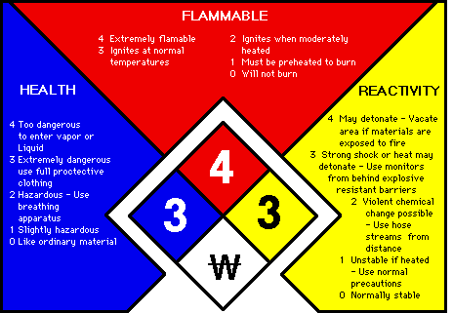
NFPA DIAMOND

Slide 24
HAZARDOUS MATERIALS STORAGE
All hazardous materials must be stored according to compatibility so that accidental mixing does not occur. (Applies to gas cylinders as well)
Use only appropriate, compatible containers. (NO MILK JUGS, food containers, drink bottles, etc.)
Minimize chemicals in inventory that are not used or not needed.
Flammable storage cabinets.

Slide 25
HAZARDOUS MATERIALS STORAGE
Containers should be inspected periodically and at least annually to assure container and label integrity
Keep all containers closed except when in use
Secondary containment can prevent serious spills and subsequent reactions
Prior to the end of each semester or upon the departure of personnel, all remaining hazardous materials should be properly identified with disposition to storage or waste disposal

Slide 26
You Might Have A Hazardous Waste If ….
The Waste Chemical is listed by the EPA as a Hazardous Waste (see EH&S web site for a list of these wastes)
A compound or solution that is:
Corrosive
Toxic
Reactive
Flammable

Slide 27
DARKROOM WASTES
When ever possible you should use an alternative to generating darkroom wastes such as digital photography.
Used fixer solution is to be poured into the silver recovery unit located in the Jenkins Art photo studio.
Insure that all containers are labeled properly.

Slide 28
STUDIO WASTES
All liquid wastes are to be placed in container in studio.
Rags containing wastes are to be placed in Rag Cans.
Paint and ink is to be placed in the hazardous waste container designated for liquids only.
DO NOT place trash, metal, glass, or sharps in flammable rag cans.

Slide 29
CHEMICAL WASTE CONTAINERS
Collect in clean chemical containers, compatible with collected material.
Containers must have a tight fitting screw on cap that will not leak if tipped. (No milk jugs, food containers, drink bottles, etc.)
EH&S will provide you a container. Contact 328-6166.
Keep container exterior free of damage, spill material, or contamination.
Do not mix incompatible wastes.

Slide 30
SATELLITE ACCUMULATION
If you accumulate waste, you are required to adhere to all EPA regulations.
Noncompliance with any hazardous waste regulation may result in substantial fines and penalties for the University and individual instructors and/or students.

Slide 31
SATELLITE ACCUMULATION
Waste must be properly segregated and stored according to compatibility
Wastes must be stored with a tight fitting screw on cap or lid and be free from leaks, damage or outside contaminants
Kept in designated area – preferably with secondary containment
Every container must remain closed except when adding waste (in fume hood)
Must be marked with accumulation start date

Slide 32
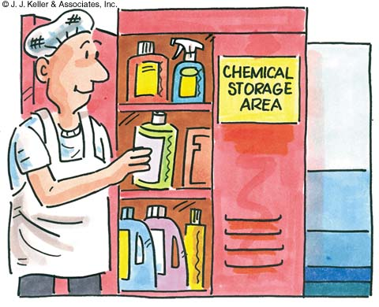
SATELLITE ACCUMULATION
Wastes can only be accumulated for up to one year.
Once a chemical is designated a “waste” or when the first drop of waste has been put into the container, a “hazardous waste” tag must be completed and placed on that container.
EH&S must be notified when containers are ¾ full.

Slide 33
HAZARDOUS WASTE LABELING
All Hazardous Waste containers must be properly labeled with EH&S tags.
These can be found on the EH&S website.
DO NOT use chemical formulas or abbreviations.
Tags must be completed and signed by the generator.
Attach the tag to the container with string, wire or rubber band.
Inspect label integrity and replace if damaged.

Slide 34
Hazardous Waste Disposal
Ensure that wastes are properly packaged, stored, and labeled.
Complete the waste pick-up request form and email to safety@mail.ecu.edu.
Provide your name, phone #, location, identity, and amounts of waste.
Waste pick-ups are conducted every Thursday.

Slide 35
NO chemicals are to be discharged into the sewer system or thrown in the trash without EH&S approval!!

Slide 36
PROTECTION FROM HAZARDS
Hazard Assessments/Safety Plans
Substitution
Work Practices
Engineering Controls
PPE
Personal Hygiene
Emergency Procedures

Slide 37
ENGINEERING CONTROLS
General Ventilation (comfort)
Dilution Ventilation
Local Ventilation
Design, Operation and Maintenance

Slide 38
PERSONAL PROTECTIVE EQUIPMENT
Proper selection (compatibility, fit, comfort)
Proper use (training)
Storage
Maintenance

Slide 39
EMERGENCY RESPONSE
Know how to respond to an emergency before the emergency occurs.
Keep the Emergency Procedures near the phone and know what to do and who to contact.
Have plans in place for fire, spills, severe weather, ventilation system failure, etc.

Slide 40
COMMON ISSUES
Written Program/Policy
Chemical Inventory/SDS’s
Inventory Control (students)
Chemical Containers/Labeling
Waste Disposal
Eating, Drinking, and Smoking

Slide 41
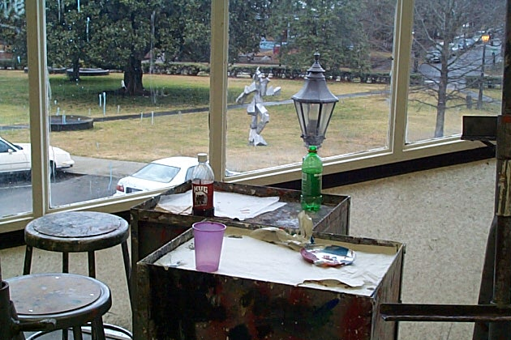
Beverage consumption in work area and use of beverage containers for chemical storage (Neither is allowed)

Slide 42
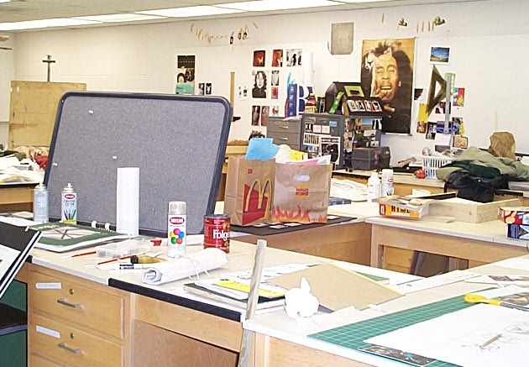
Food storage and consumption in the work area

Slide 43
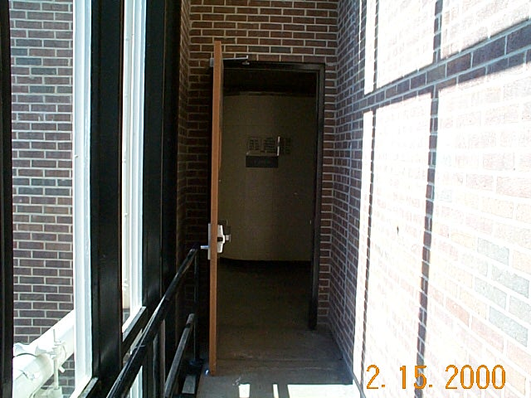
Do not prop open fire doors with any object.

Slide 44
COMMON ISSUES
PPE Selection and Use.
Attire. (Closed toed shoes, loose fitting clothes, etc.)
Housekeeping. (Clutter of flammable materials, chemical storage, hazardous waste storage, etc.)
New Operations. (Must have all equipment and control measures)

Slide 45
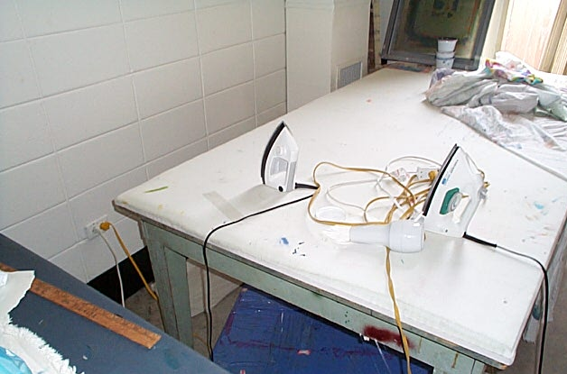
Use of extension cords and fire hazard from hot iron in contact with cords.

Slide 46
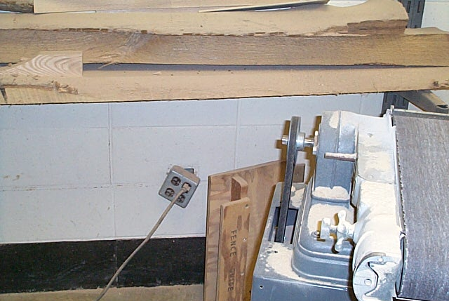
Missing belt guard and damaged receptacle.

Slide 47
WHAT PERSONNEL NEED TO KNOW
What is the Hazard Communication Plan and where is it located?
What are SDS’s and where are they?
What should be done if there is a spill, fire or other emergency?
Where is the emergency eye wash/safety shower and how is it used?
What are PEL’s and where are they?

Slide 48
WHAT PERSONNEL NEED TO KNOW
How can a release be recognized?
What are the health hazards associated with the materials used in your work area?
What are signs and symptoms of exposure?
What measures (work practices, emergency procedures, PPE, etc.) can be taken to protect yourself from the hazards associated with the materials you use?

Slide 49
HOW TO HAVE A SAFE ENVIRONMENT
INFORMATION – Learn the hazards associated with your operation and share it with others. (faculty, staff, students)
TRAINING – Ensure that all know how to work safely with hazardous materials and equipment.
LEADING BY EXAMPLE – Model safe behavior.
ENFORCEMENT – Clearly communicate expectations and do not tolerate improper or unsafe behavior.r

Slide 50
Quiz and Contact Information
Please complete the attached quiz to successfully meet all the requirements of this training.
Click on the link and it should take you to the quiz. If you are not in slideshow mode, right click the link and click “Open hyperlink”.
Art Safety Quiz
For assistance contact EH&S at:
328-6166
safety@ecu.edu

