Slide 1
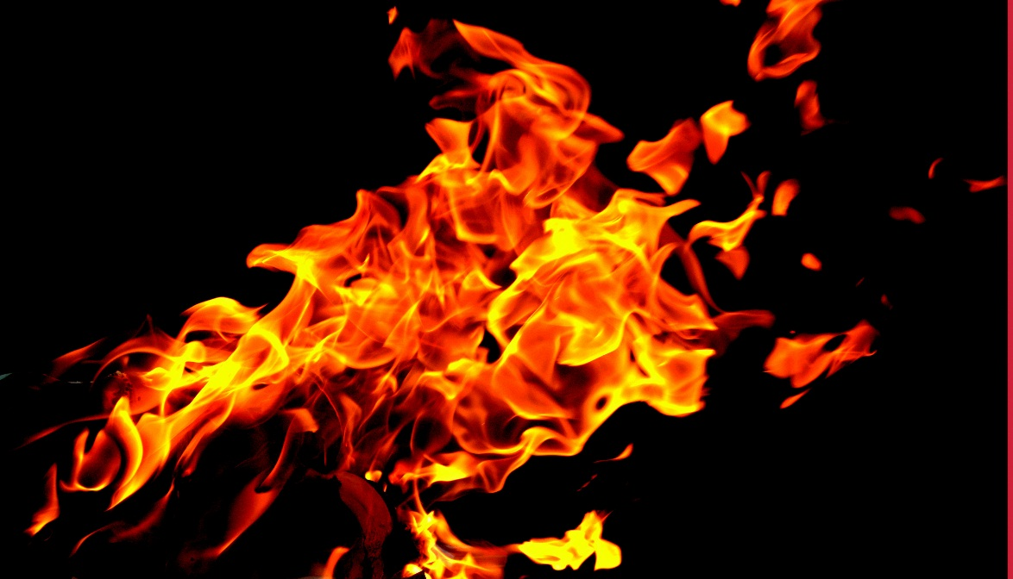
FIRE AND LIFE SAFETY TRAINING
Office of Environmental Health and Safety
East Carolina University
Notes:
Welcome to the Fire Life and Safety Training for clinical staff presented by the Office of Environmental Health and Safety. This presentation will include the importance of evacuation plans, procedures, fire prevention, common types of fires, and extinguisher information. There is a short quiz at the end. You may use your notes or course materials to assist you. Once completed, you must submit to quiz to receive credit for the training. You will be sent confirmation via email.

Slide 2
Objectives
Importance of Evacuation Plans
Evacuation Procedures
Emergency Procedures
Patient Evacuation
Common Causes of Fires
Fire Prevention
Types of Fire Extinguishers
Notes:
From this training, you should learn about evacuation procedures including different types of fire notification systems, emergency exits, fire doors, any special procedures for evacuating patients, why Emergency Evacuation/Action Plans are so important, some common causes of fires in clinics, various fire prevention tips, as well as the different types of fire extinguishers and what they are used for.

Slide 3
ECU Policy
EVACUATE IMMEDIATELY!
Regardless of the internal policies that may have been in place previously, current University policy is to evacuate the area where a fire occurs regardless of the amount or cost of equipment that may be lost.
Notes:
Do not attempt to fight a fire unless it is your only means of escape. Do not re-enter the building for any reason, not even to attempt a rescue of an individual still inside the building.

Slide 4
There Is A Fire:
What Do I Do?
Upon discovering a fire, immediately sound the building fire alarm and/or alert other occupants.
From outside of the building:
  Dial 911
  ECU Police
    East Campus, 328-6787
    West Campus, 744-2246
  Go to a campus ‘Blue Light Phone’.
Provide your name, department, and location of the fire.
Notes:
Immediately sound the alarm and alert all occupants upon discovering a fire. From outside the facility (using a blue light emergency phone or cell phone), call the Police Department at the number given according to your location. Provide them with your name, department and the location of the fire.

Slide 5
Notification System
An alarm system must be in place to notify the staff and patients of a fire. This may include one or more of the following:
Public address system (PA)
Alarm pull stations that sound an
audible alarm.
Voice – call out ‘FIRE’ and location
(if no electronic alarm system)
Notes:
If the building has a fire alarm, activate a pull station on your way out of the building. If the building does not have an alarm system, yell a pre-determined signal such as “Code Red” or “Fire” to notify all building occupants that there is a fire. Once outside the building, the police should be called using a cell phone or a blue light emergency phone, located throughout campus.

Slide 6
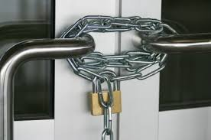
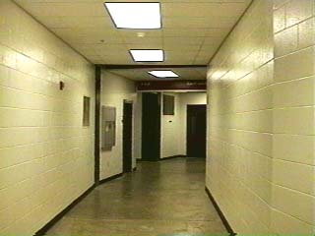
Means of Egress
Employees must know two means of egress in case one becomes blocked during an emergency evacuation.
A continuous and unobstructed way of exit travel from a building or structure.
Routes of Egress must be unobstructed and unlocked while the structure is occupied.

Slide 7
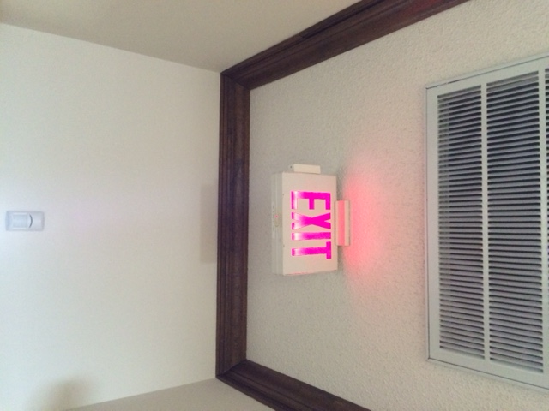
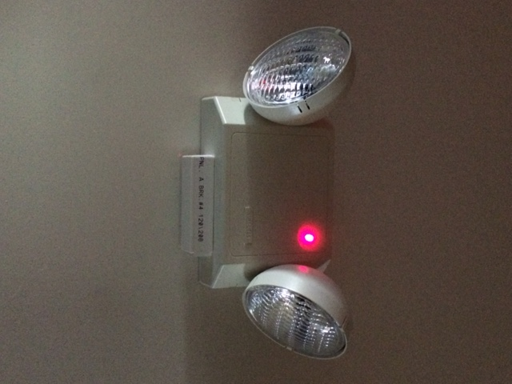
Emergency Exits
All exits must be clearly visible – no mirrors, curtains, or other items covering the signs or doors.
Doors which may be mistaken as exits must be clearly labeled as “Not an Exit.”
All exits must be clearly illuminated with at least 5 candlepower, and have backup lighting.
Notes:
All exits must be clearly marked, remain unlocked, and should not be blocked. Mirrors shall not be placed in or adjacent to any exit in such a manner as to confuse the direction of exit.

Slide 8
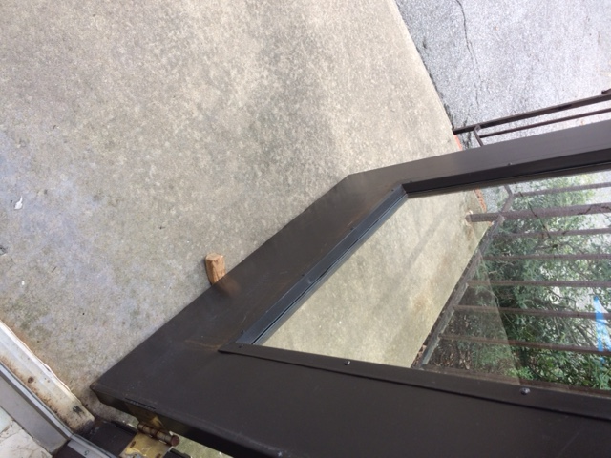
Fire Doors
  Door stops, wedges and other unapproved hold-open devices are prohibited on fire doors.
  Swinging fire doors shall close from the full-open position and shall latch automatically.
NO!!
Notes:
Fire doors should never be propped open with door stops, wedges, or any other device. These doors must be free to close in the event of a fire. The purpose of fire doors is to contain smoke and fire and prevent it from spreading throughout the building.

Slide 9
Building Evacuation
Proceed to nearest exit in an orderly fashion, closing doors behind you.
Assemble at the designated meeting location and account for all staff and/or students.
Provide safety representatives with information about people still in the building, location of ‘Area of Rescue’, etc.
Never re-enter a building until instructed to by the police department, fire department, or EH&S staff.
Notes:
Individuals should be assigned responsibility for checking rooms and closing doors. DO NOT USE ELEVATORS! When out of the building, all members should proceed to designated meeting location. Use a check in sheet to account for patients, visitors, and staff. The Safety Representative for your office or clinic should report to the Police Department and Greenville Fire and Rescue. Remember to wait for clearance to re-enter to building.

Slide 10
RACE Method Of Evacuation
R Rescue All Persons In Immediate Danger!
A Alarm- Always Pull The Alarm and Call ECU Police Department.
C Contain The Fire By Closing the Windows and Doors.
E Evacuate building. Extinguish the Fire Only if You Are Trained and Confident.
Notes:
The RACE method is located on the Emergency Evacuation Plan and everyone should know this vital information.

Slide 11
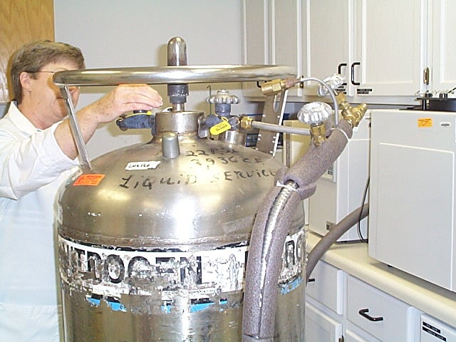
Emergency Procedures
Staff members should have specific roles in equipment shutoffs if necessary.
All doors should be checked for visitors and shut on the way out in order to contain smoke and fire.
Notes:
Shut off all equipment that may accelerate the fire (compressed gases) and remember to close all doors to contain any fires or smoke that may be present. What are your specific roles in your facility’s emergency procedures?

Slide 12
Regulatory Requirement
The Occupational Safety and Health Administration (OSHA) requires Emergency Action Plans (EAP) under 29 CFR 1910.38.
  EAPs ARE REQUIRED!
Notes:
An emergency action plan must be in writing, kept in the workplace, and available to employees for review. It must include: procedures for reporting a fire or other emergency, procedures for emergency evacuation, procedures to be followed by employees who remain to operate critical plant operations before they evacuate, procedures to account for all employees after evacuation, procedures to be followed by employees performing rescue or medical duties, and the name or job title of every employee who may be contacted by employees who need more information about the plan or an explanation of their duties under the plan.

Slide 13
Emergency Action Plan
All employees should have read the Emergency Action Plan (EAP) and fully understand it.
It is important to update Safety Representatives and contacts whenever a change is made.
The meeting locations should be away from any traffic and equipment areas that might be a danger.
Updated plans should be submitted annually to the Office of Environmental Health and Safety.

Slide 14
Training
All faculty and staff should be trained on Emergency Action Plans and participate in scheduled drills.
  Fire drills should be conducted annually.
  Emergency Action Plan training should be conducted by the Building Administrator/Captain or Safety Representative for the department.
This training should be updated annually and/or when staff or the facility changes.
This training is specific and should be conducted by your safety representative or the individual in charge of completing the EAP.
Notes:
Training should take place for your specific evacuation plan and specific responsibility. The Emergency Evacuation Procedures should be updated at least annually, or when changes are made to the facility (construction affects evacuation or meeting locations) or there are staffing changes. Forward updated plans to the Office Environmental Health and Safety.

Slide 15
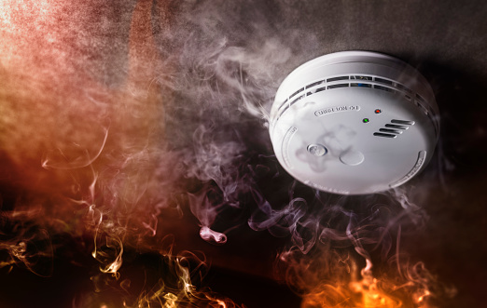
Common Causes of Fires in the Workplace
Electrical Malfunctions/Faulty Equipment
Clutter
Improper Storage and Accumulation of Flammable/Combustible Material
Human Error (incorrect use of equipment, leaving cooking unattended)
Arson
Notes:
Some common causes of fires in heath care facilities include damaged electrical cords, open flames or hot surfaces, and compressed gas cylinders. Which of these apply to your facility?

Slide 16
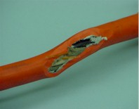
Electrical Safety
Extension cords and flexible cords cannot be a substitute for permanent wiring.
Regularly inspect electrical cords for damage.
Make sure extension cords are not overloaded.
Notes:
Approved, heavy duty extension cords (14 gauge or larger) should be for TEMPORARY use only. It proposes many safety issues having cords laying around. A person can trip over them, knock something over and possibly injure themselves in the process. The cords should not be strung through walls, be placed anywhere they are vulnerable to damage, and not set up where they would have to go under doors or floors. If a cord has any visible wear report the damage and make arrangements for repair. Be aware when using extension cords and pay close attention when using heat.

Slide 17
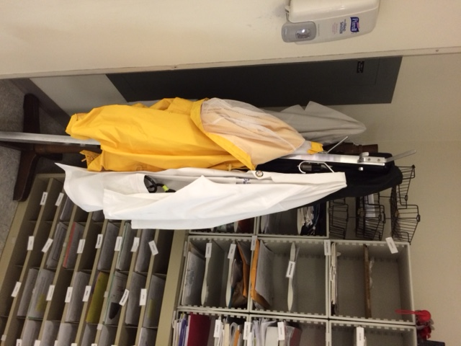
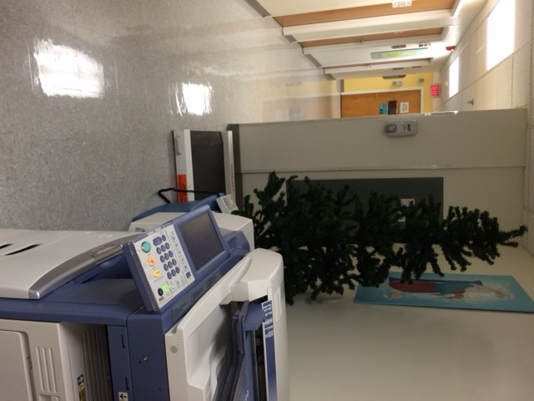
Electrical Safety
Clearance of not less than 36 inches shall be provided between all electrical service equipment (electrical panels) and storage.
Multi plug adaptors, such as cube adaptors, unfused plug strips or any other device not complying with NFPA 70 are prohibited.
Electrical Panel
Electrical Panel

Slide 18
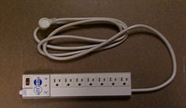
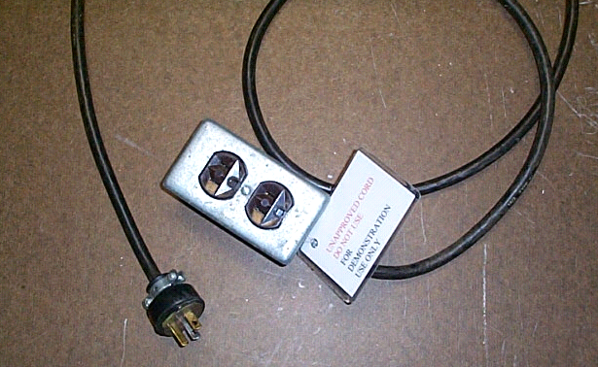

Electrical Safety
Surge Protectors are the only approved means of multiplying a receptacle.
Extension cords are NOT an approved means of permanent wiring.
All appliances MUST have a UL label.
Notes:
Use only heavy-duty (14 gauge or larger) UL listed transient voltage surge protectors if you need extra receptacles but remember: do not overload the outlet capacity.
The use of multi-plug adaptors is not permitted because it will overload the receptacle and is produces a greater risk of fire.

Slide 19
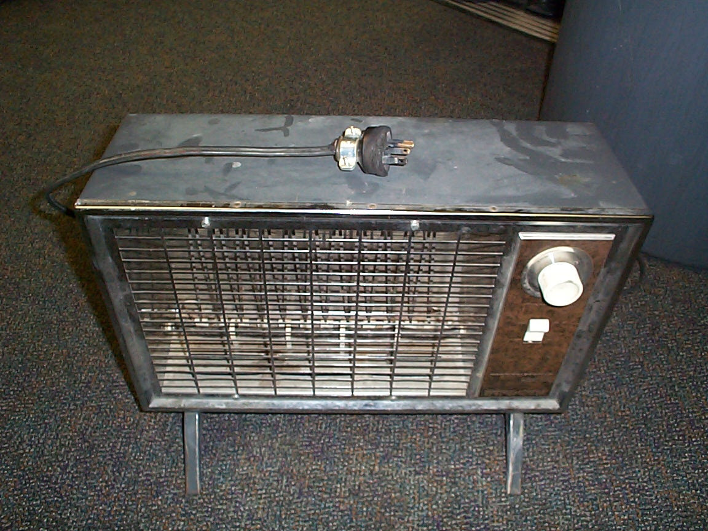
Portable Space Heaters
Space heaters are prohibited from use in all State-owned buildings.

Slide 20
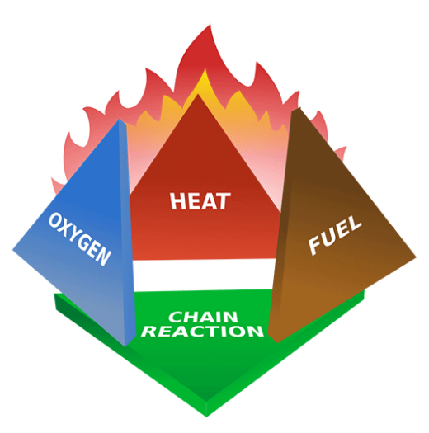
How Does a Fire Work?
Four components
Need all four components to start a fire
Fire extinguishers remove one or more of the components
Oxygen is required as a catalyst
  May come from the air OR from the fuel itself
Notes:
A fire needs four components to exist and spread. A fuel source must be exposed to a heat supply. Oxygen, from the air or oxygen tanks, acts as a catalyst to make the reaction take place, which creates a flame. The more the fuel and oxygen supply, the bigger the flame. Fire extinguishers are used to ‘extinguish’ one of the four components that allow the fire to exist.

Slide 21
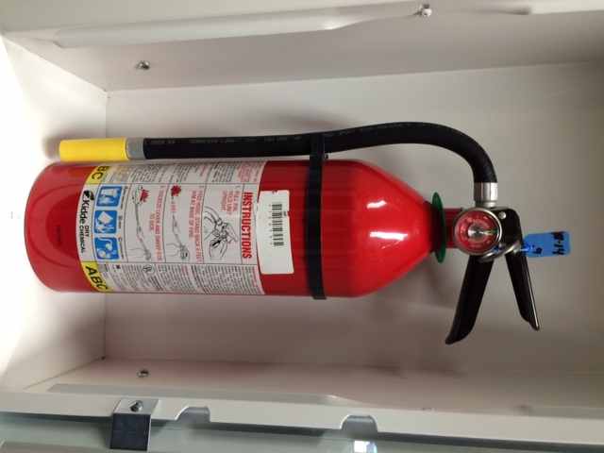
Portable Fire Extinguishers
Locate and identify extinguishers so that they are readily accessible.
Only approved extinguishers shall be used.
Maintain extinguishers in a fully charged and operable condition.
Notes:
All personnel must be able to identify all extinguishers. Do not tamper with the extinguishers. If any of the extinguishers have been tampered with or are damaged or discharged for any reason, REPORT IMMEDIATELY!!

Slide 22
How to Use an Extinguisher
P A S S Method
P: Pull the pin.
A: Aim extinguisher nozzle at the base of the flame.
S: Squeeze trigger while holding the extinguisher upright.
S: Sweep the extinguisher from side to side, covering the area with the extinguisher agent.
Notes:
ECU policy is to evacuate the area where a fire occurs. Do not attempt to fight a fire unless you have been trained to do so or it is your only means of escape.
In order to operate a fire extinguisher, you must have the appropriate training. Training is coordinated with the Office of Environmental Health and Safety with the Facility Services Plumbing Shop.
When using an extinguisher, remember to Pull, Aim, Squeeze, and Sweep.

Slide 23
Classification of Fires & Extinguishers
A
Class A
  Wood, Paper, Rags
Class B
  Gasoline, Oil, Grease
Class C
  Electrical
  Class K
    Cooking Oils
  Class D
    Combustible Metals- Magnesium, Lithium
Extinguishers
Most common: ABC
Class D and K: Specific extinguishers for those areas where those hazards present.
B
C
K
D
Notes:
For the vast majority of fuel sources for fires, the common ABC extinguisher can be used. Limit storage of combustible and flammable materials. If a large amount of combustible or flammable materials were to ignite, the fire would easily and quickly spread. Electrical equipment should be inspected to make sure wiring isn’t compromised nor have loose electrical contacts. Combustible metals are generally in an industrial or lab setting.

Slide 24
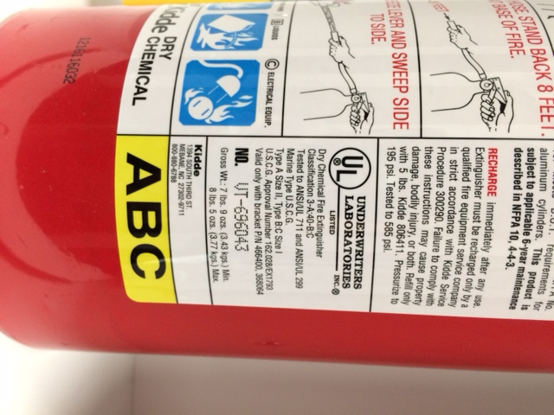
Multi-Class Ratings
There are several types of multi-class extinguishers: A-B, B-C, or A-B-C.
Be sure the correct extinguisher is provided for the hazards.
Generally, ABC combinations are used to extinguish a wide variety of fires including Combustibles, Flammable Liquids, and Electrical Fires.
Notes:
Generally, ABC combinations are used at to extinguish a wide variety of fires including Combustibles, Flammable Liquids, and Electrical Fires.
Class C extinguishers require the use of electrically nonconductive extinguishing media.

Slide 25
Types of Extinguishers
      Multi-Purpose Dry Chemical, a powder (ammonium phosphate)- smothers and breaks down chemical reaction; ABC
      Carbon Dioxide- smothers, cools; B and C
      All Purpose Water- cools; only for Class A
      Wet Mist Foam-smothers, cools; K
      Dry Chemical, a powder (ex. sodium bicarbonate)-smothers; BC
      Dry Powder (ex. Salt, copper, graphite based)- smothers and absorb heat; D
Notes:
Different kinds of extinguishers are used for various media to put them out in case of a fire.
Water is used for Class A combustibles.
CO2 or Carbon Dioxide is used for Class B & C- flammable liquids and electrical fires.
Dry Chemicals are used for Classes A, B, & C fires.
Wet Mist, which turns to foam upon usage, for Class K fires.
Dry Powder is only used on Class D metals fires.
DO NOT PUT BC or ABC dry chemical on combustible metal fires (could cause an explosive reaction) and the opposite is true- Class D dry powder probably ineffective with other types of fires.

Slide 26
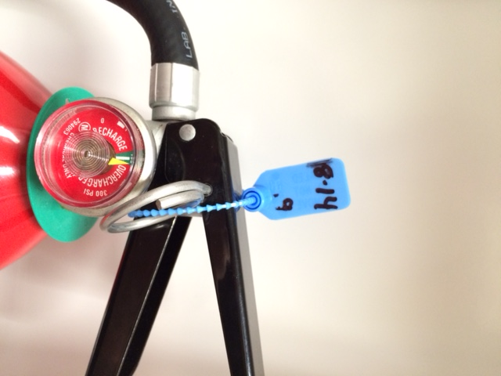
Fire Extinguishers
  Inspection, Maintenance and Testing
    Visually inspected monthly
    Maintained annually
    Dry Chemical- 6 yr. maintenance /12 yr. hydrostatic test
    Carbon Dioxide / Water- 5 yr. maint. /5 yr. hydrostatic test
    Halogenated (IT rooms)- 6/12 yr. cycle
Annual Inspection Tag
Fire extinguishers on ECU property are maintained by Facilities Services via the Life Safety Department.
Notes:
Fire extinguishers on ECU property are maintained by Facilities Services via the Life Safety Department. 12-year hydrostatic test the is the same for all, but for internal maintenance is different. If nonrechargeable extinguishers are bought, dry chemical (usually ABC), DO NOT require a 6 yr. maintenance, but must be removed from service after 12 years. (NFPA 10, Table F.7.3.2). The inspection record is recorded on the tag hanging from the extinguisher.

Slide 27
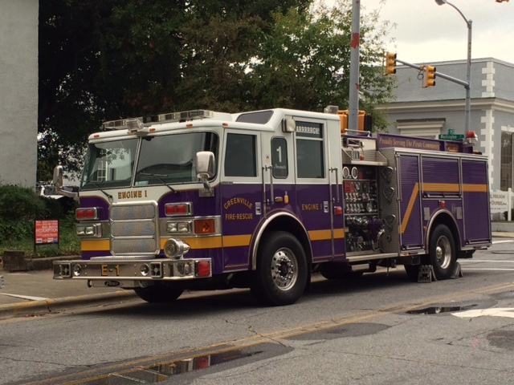
Partnership with GFR
Greenville Fire & Rescue:
  Pre-fire planning.
  Campus building surveys.
  Training / Education.
Authority having jurisdiction is the State Dept. of Insurance, Office of State Fire Marshal.
  Conduct annual inspections for fire and life safety compliance.

Slide 28
Questions to ask yourself?
Where is the nearest fire alarm pull station?
Where is the nearest fire extinguisher?
Where are the primary and secondary exits?
Where are the primary and secondary designated meeting locations?
Where is the emergency procedures manual?
What is your specific role in patient evacuation and emergency equipment shut-off?
Notes:
Are you able to answer these questions regarding Emergency Evacuation Procedures for your facility?

Slide 29
Questions and Comments
Office of Environmental Health and Safety - 328-6166 or
safety@ecu.edu
Office of Radiation and Biological Safety – 744-2070
ECU Police – 328-6787 East Campus
ECU Police – 744-2246 HSC Campus

Slide 30
Quiz
In order to receive credit for this training, you must complete the
QUIZ.
You will be sent confirmation via email.

