Slide 1
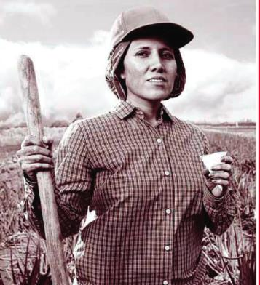
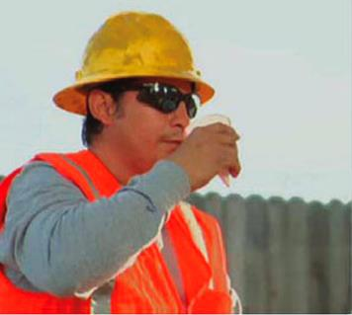
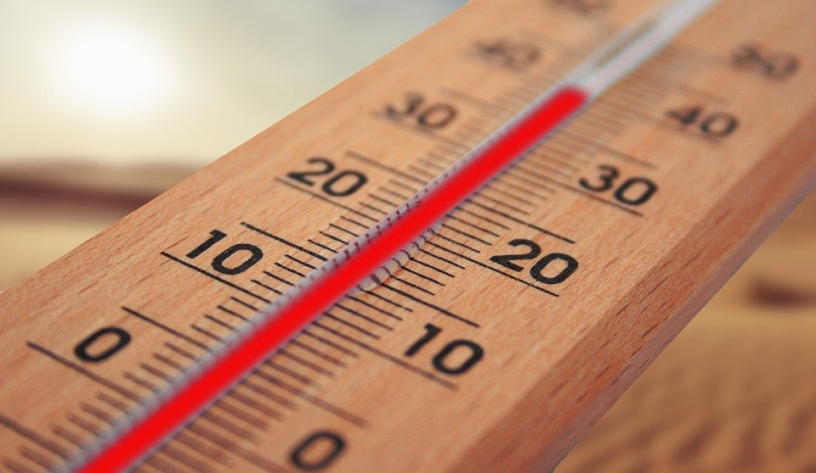
Occupational
Heat Stress
Presented by
ECU Office of Environmental Health and Safety

Slide 2
Individuals At Risk
All individuals who work in hot environments (inside and outside) are at risk of developing heat stress.
More intense and strenuous workloads, put individuals at a greater risk.
Wearing PPE such as respirators and protective suits can also increase this risk.

Slide 3
Contributing Factors
Environmental Factors
Temperature
Humidity
Radiant Heat
Air Velocity
Temperature is not the only indicator!!

Slide 4
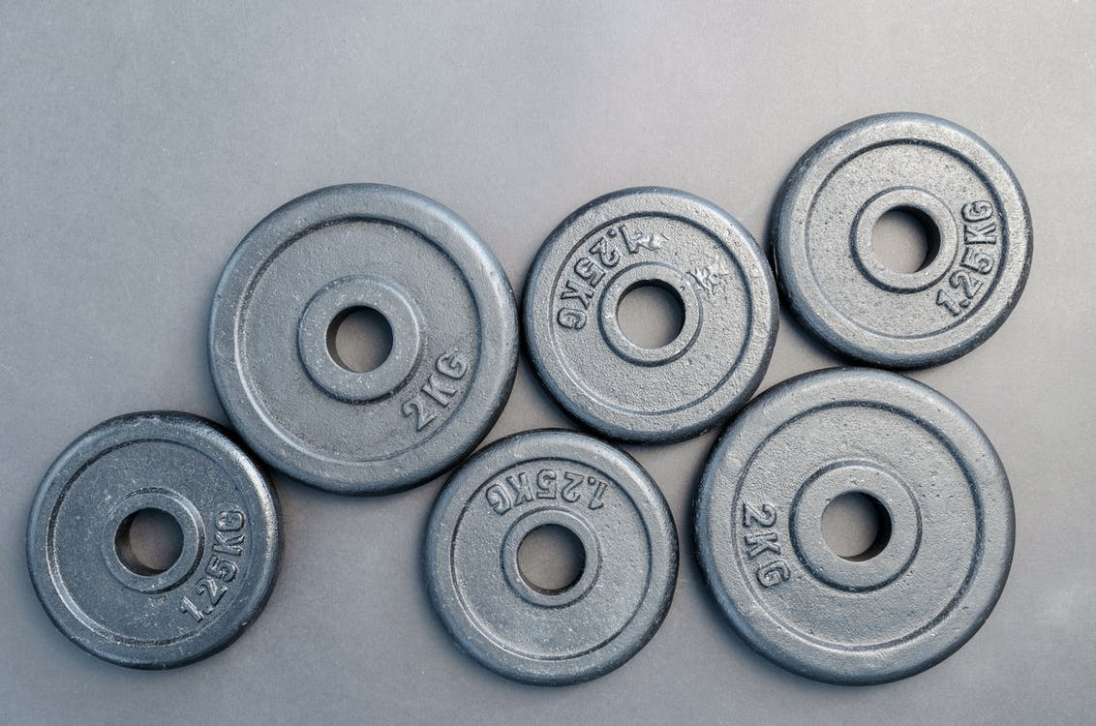
Contributing Factors
Personal Factors
Age
Weight
Fitness
Acclimatization – increased tolerance to heat that comes from working in a hot environment for a period 1-2 weeks.

Slide 5
The Body’s Response to Heat
Increased Blood Circulation
Blood is circulated to the skin which increases skin temperature and allows the body to give off excess heat through the skin.
This is why your face turns red when you are hot.
However, physical labor requires blood to fuel the muscles; therefore, less blood is available to flow to the skin surface and because of this, less heat is released from the body.

Slide 6
The Body’s Response to Heat
Sweating
Sweating is an effective way to cool the body when humidity is relatively low.
Sweating is most effective when the sweat evaporates from the skin rather than drips off or is wiped off.
A young male can sweat as much as one quart per hour. (2-3 gallons per day)

Slide 7
Heat Disorders
Heat Rash
Heat Cramps
Heat Exhaustion
Heat Stroke

Slide 8
Heat Disorders
Heat Rash
Also known as “Prickly Heat.”
Occurs when sweat cannot freely evaporate from the skin and sweat ducts become plugged. This inflammation can cause a red rash.
Can be prevented by wearing clothes that allow sweat to evaporate as well as bathing regularly and drying the skin.

Slide 9
Heat Disorders
Heat Cramps
Cramps in the arms, legs or abdomen
Occur in individuals who sweat profusely then drink large quantities of water, but do not adequately replace the body’s salt loss.
To prevent, ensure that salts are replaced during and after heavy sweating.

Slide 10
Heat Disorders
Heat Exhaustion
Mild form of shock caused when the circulatory system begins to fail as a result of the body’s inadequate effort to give off excessive heat.
Although not an immediate threat to life, if not properly treated, could evolve into heat stroke.

Slide 11
Heat Disorders
Heat Exhaustion - Symptoms
Skin is clammy and moist
Extreme weakness or fatigue
Nausea
Headache
Complexion pale or flushed
Body temperature normal or slightly elevated

Slide 12
Heat Disorders
Heat Exhaustion - Treatment
Do not leave the person alone
Move to a cool place to rest
Drink water or electrolyte fluids
Treat for shock, if necessary
If unconscious, fails to recover rapidly, has other injuries, or has a history of medical problems, seek medical attention.

Slide 13
Heat Disorders
Heat Stroke
Severe and sometimes fatal condition resulting from the failure of the body to regulate its core temperature.
The body’s normal cooling mechanisms stop functioning, sweating stops.
True medical emergency requiring immediate medical attention.

Slide 14
Heat Disorders
Heat Stroke - Symptoms
Stop Sweating
Rapid Pulse
Mental Confusion
Loss of Consciousness
Convulsions
Body Temperature > 105
Hot, dry skin
Can die unless treated promptly

Slide 15
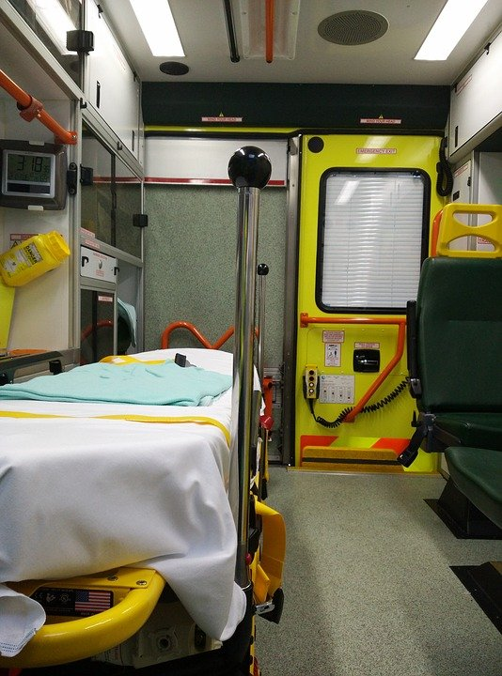
Heat Disorders
Heat Stroke - Treatment
Call 911
Remove victim to a cool area
Soak clothing with cool water and fan vigorously to increase cooling
Monitor vital signs

Slide 16
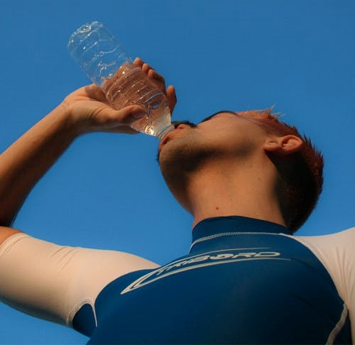
Prevention Methods
Acclimatization
Work in pairs
Drink plenty of cool water or electrolyte replacement fluids even if not thirsty. (One small cup every 15-20 minutes)
Be able to recognize early signs & symptoms of heat-induced illness and take appropriate action to prevent serious heat disorders.
Schedule most strenuous work during the coolest times of the day.

Slide 17
Prevention Methods
Spend as little time as possible in direct sunlight.
Take frequent breaks in cool, shaded areas.
Wear light, loose fitting, clothing.
Avoid caffeine, which can make the body lose water.
Rotate workers in and out of hot areas if possible.

Slide 18
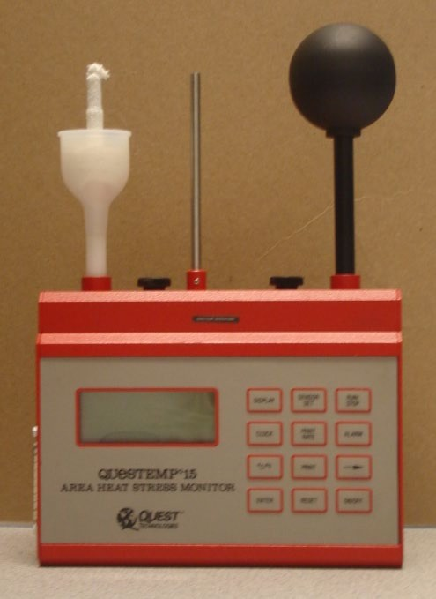
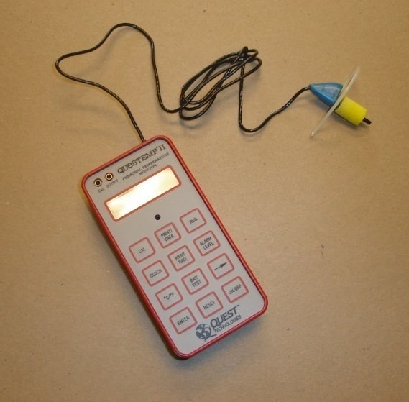
Heat Stress Measurement
Area Heat Stress Monitor
Personal Heat Stress Monitor

Slide 19
Wet Bulb Globe Temperature Index
WBGT is a number that is calculated as a combination of humidity, radiant, and ambient temperature readings.
This number is then combined with work load to determine heat stress potential.
The following table displays the recommended work/rest regimen for corresponding WBGT values.

Slide 20
Work/Rest Regimen
PERMISSIBLE HEAT EXPOSURE THRESHOLD LIMIT VALUES
 | Work |  |  | Load*
Work/rest regimen | Light |  | Moderate |  | Heavy
Continuous work | 30.0°C | (86°F) | 26.7°C | (80°F) | 25.0°C | (77°F)
75% Work, 25% rest, each hour | 30.6°C | (87°F) | 28.0°C | (82°F) | 25.9°C | (78°F)
50% Work, 50% rest, each hour | 31.4°C | (89°F) | 29.4°C | (85°F) | 27.9°C | (82°F)
25% Work, 75% rest, each hour | 32.2°C | (90°F) | 31.1°C | (88°F) | 30.0°C | (86°F)
*Values are in °C and °F, WBGT. These TLV's are based on the assumption that nearly all acclimatized, fully clothed workers with adequate water and salt intake should be able to function effectively under the given working conditions without exceeding a deep body temperature of 38°C (100.4° F). They are also based on the assumption that the WBGT of the resting place is the same or very close to that of the workplace. Where the WBGT of the work area is different from that of the rest area, a time-weighted average should be used (consult the ACGIH 1992-1993 Threshold Limit Values for Chemical Substances and Physical Agents and Biological Exposure Indices (1992). These TLV's apply to physically fit and acclimatized individuals wearing light summer clothing. If heavier clothing that impedes sweat or has a higher insulation value is required, the permissible heat exposure TLV's in Table III:4- 2 must be reduced by the corrections shown in Table III:4-3.
Source: ACGIH 1992.

Slide 21
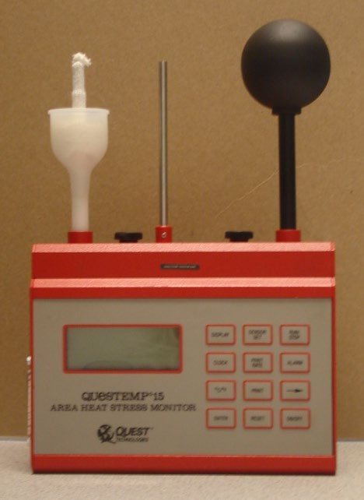
Heat Stress Monitoring
If you are unsure of the Heat Stress Potential that your employees are exposed to, contact EH&S to conduct Heat Stress Monitoring.

Slide 22
Questions
To receive credit for this training please complete the linked
QUIZ
211 South Jarvis Street, Suite 102, Greenville NC 27858
Online: www.ecu.edu/oehs
Email: safety@ecu.edu
Phone: (252) 328-6166

