Slide 1
Continuity Planning for East Carolina University
L a u r e n G u n t e r
Continuity / Emergency Planner
Environmental Health & Safety
g u n t e r a @ e c u . e d u
328-6166
ECU Ready
a continuity planning tool for ECU

Slide 2
General Dwight D. Eisenhower
“In preparing for battle I have always found that plans are useless, but planning is indispensable.”

Slide 3
Agenda
Emergency Management at ECU
What is Continuity Planning?
ECU Continuity Planning Objectives
Continuity Planning Process
Overview of ECU Ready
ECU Ready Demonstration

Slide 4
Emergency Management at ECU
Emergency management is the managerial function charged with creating the framework within which communities reduce vulnerability to hazards and cope with disasters.

Slide 5
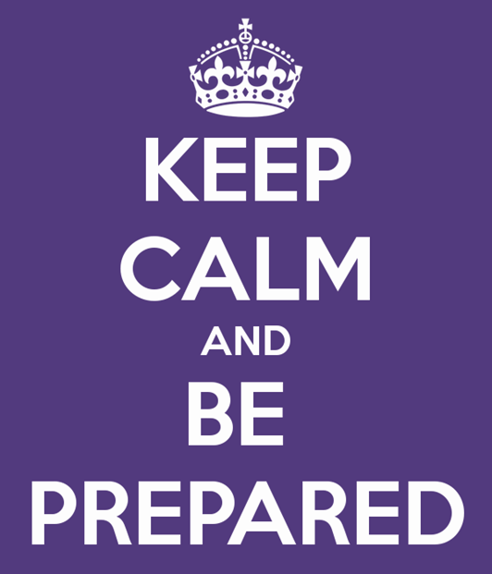
Emergency Management at ECU
The Office of EH&S has responsibility for emergency management.
Protecting the university’s mission of instruction, healthcare, research, and outreach.
We collaborate with many offices, including: University Police, News Services and Campus Operations, etc.

Slide 6
Emergency Management…
is the process of:
has several components:
Prevention
Preparation
Mitigation
Response
Recovery
Planning
Training
Testing
Drills
Corrective Actions
what you’re now preparing to do
we will discuss this later

Slide 7
Continuity / Emergency Planner
Provide leadership in coordinating, assessing, developing, and communicating continuity planning principles
Educate campus departments on the development, testing, and maintenance of your continuity plan
Advise departments / units toward completion of their plan(s)

Slide 8
What is Continuity Planning?
The consideration of the factors and steps necessary to prepare for a crisis so that the organization can manage and survive the crisis and ensure its continued viability.

Slide 9
What is Continuity Planning?
A structured approach to identify what can go wrong
Purpose is to put a plan in place to reduce those risks
Establish what to do if:
We do not have our people
(Reduced workforce)
We do not have our buildings
(Loss of access to a facility)
We do not have our inputs
(Loss of services)

Slide 10
What is Continuity Planning?
A collection of:
Resources
Actions
Procedures
Information
It is NOT a project
It is NOT a one-time task
It IS a “mind-set”
It IS on-going
And it MUST BE communicated, trained, tested, reviewed continuously

Slide 11
Importance of Continuity Planning
Creating and maintaining a continuity plan helps ensure that an institution has the resources and information needed to deal with emergencies.

Slide 12
Ask yourself & your unit…
Could you operate without your building?
What if you had to evacuate your building and could not access it for 3 days to 2 weeks?
What impact would your inability to continue operations have on the rest of the University?
What if 50% of your staff is absent?

Slide 13
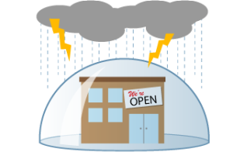
Potential Hazards & Vulnerabilities
Water Supply Disruption
Train Derailment
Power Outage
Building Fire
IT Malfunction
HazMat Spill
Flooding
High Winds
Lightning
Tornadoes
Hurricanes
Pandemic
etc…

Slide 14
ECU Continuity Planning Objectives
Continuity Planning:
Enables the University to quickly and effectively manage and resolve emergency situations
Keeps performance in line with University, State, and Federal protocols and standards
Enables academic and administrative units to:
Concentrate on what they know best
Call on other resources outside their familiar unit components

Slide 15
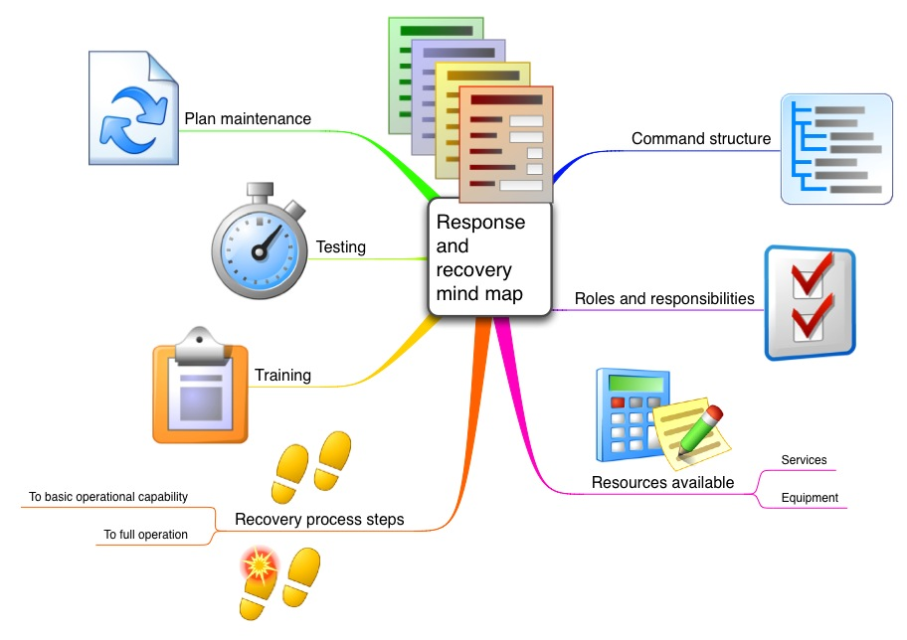
Continuity Planning Process

Slide 16
Process of Continuity Planning
1. Identify: Risk Assessment
2. Analyze: Impact Analysis
3. Design: Plan Development
4. Execute: Execution (as needed)
5. Measure: Plan Testing & Maintenance

Slide 17
Process of Continuity Planning
Campus-wide risk assessment, impact analysis, and hazard mitigation
Determine critical departments on campus
Develop campus-wide continuity plan
Develop departmental continuity plans for those critical departments identified
Annually review, test, and revise continuity plans

Slide 18
Process of Continuity Planning
Decide on single plan or multiple plan
Appoint a COOP Developer for a single plan or multiple COOP Developers for each unit with a department
Set scheduled meetings until the plan is complete

Slide 19
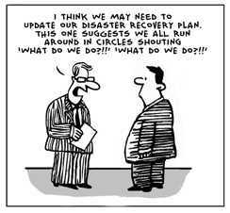
Process of Continuity Planning
Update your continuity plan, add as much detail as you see fit
Submit your plan for review to EH&S
Annually review, test, and update your continuity plan

Slide 20
Overview of
Readiness is cheap & easy!
… only if you think about it ahead of time …

Slide 21
Overview of ECU Ready
Continuity Planning Tool for institutions of higher education
Template for unified plans
Instructions offer assistance in completing template
All information is saved on a secure server
Designed so users only have to enter department-specific information
Easy to update and maintain
Meet auditing requirements

Slide 22
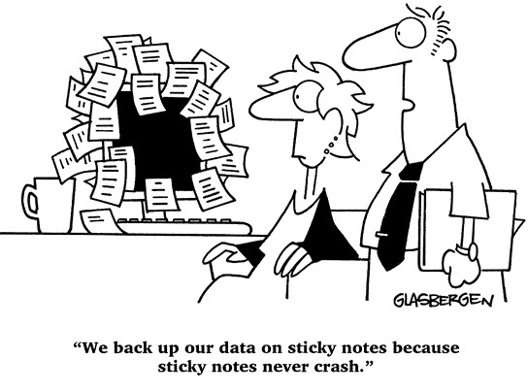
Overview of ECU Ready
Customizable
Hosted & Supported by ITCS
Do-It-Yourself (DIY)
Little or No End-User Training Needed
Lean Content, Clear Purpose

Slide 23
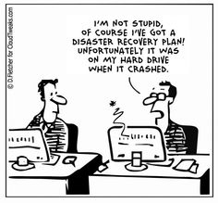
Demonstration
us.ready.kuali.org/ecu

Slide 24
Federated Login

Slide 25
Welcome & Begin

Slide 26
Choose a Plan

Slide 27
Your Plan’s Home Screen

Slide 28
Your Plan’s Home Screen
In-Progress, Complete, Current
Name, Division, Head of Unit – Do NOT Change w/o Permission
Authorized Users of Your Plan – Ask to Add/Remove Users
View / Print Interview Forms
View / Print Your Entire Plan, Sections, Documents
Go Back to Main Menu
Copy Entire Plan – Do NOT Use
Sign-Off when Plan is Complete
Annually Sign-Off when Plan is Reviewed/Tested/Revised

Slide 29
Continuity Planning Steps
About your department/unit
# personnel
type of dept
dept description
location(s)
evacuation plans
Information Tech
IT requirements
how to restart
action items
Critical Functions
major functions that your unit normally performs

Slide 30
Continuity Planning Steps
Instruction
academic instruction
graduate / undergraduate
Key Resources
staff basics
telework plan
stakeholders
equipment / supplies
facilities & transportation
Action Items
goals for mitigating disasters

Slide 31
Critical Functions

Slide 32
Example of Critical Function

Slide 33
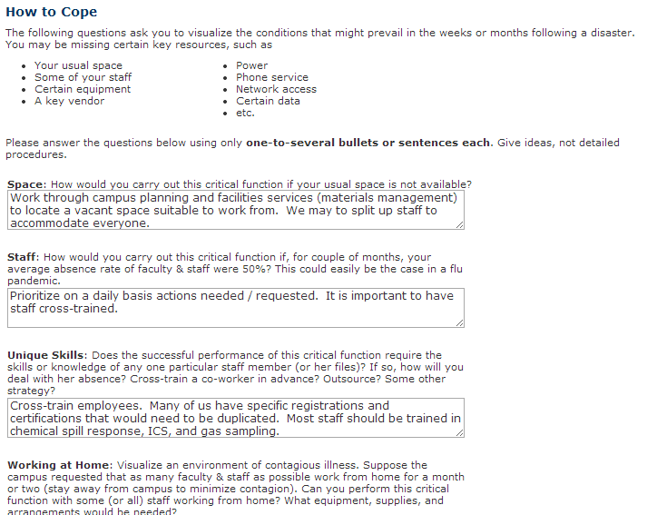
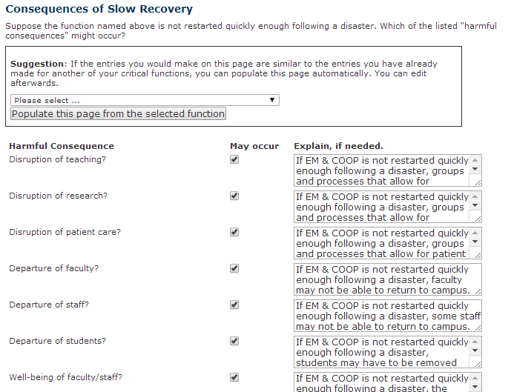
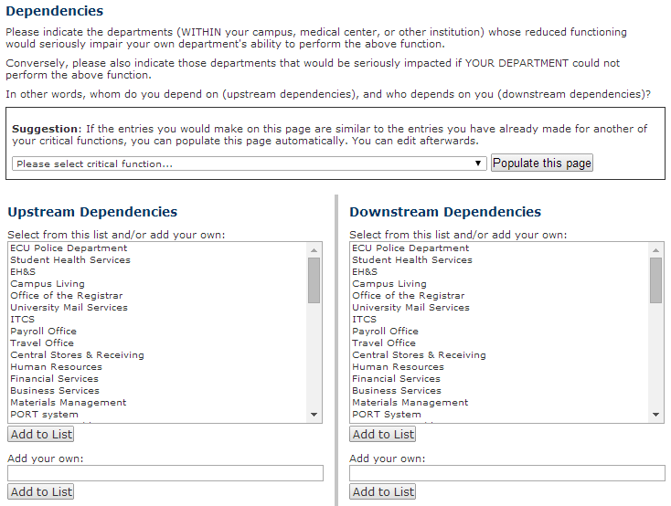
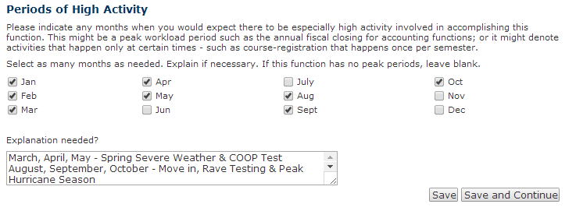
Critical Function Sub-Pages

Slide 34
Information Technology Sub-Pages

Slide 35
Key Resources Sub-Pages
Succession of Leadership
Telework Plans (if applicable)
Stakeholders – Contact Information
Document Summary
Office Equipment, Other Equipment, & Supplies
Facilities, Utilities, & Transportation

Slide 36
Action Items
A stitch in time saves nine.
An ounce of prevention is worth a pound of cure.
It wasn’t raining when Noah built the ark.
Preparation through education is less costly than learning through tragedy.
Action items are the most important things in a continuity plan.
Action items are ideas, not commitments.

Slide 37
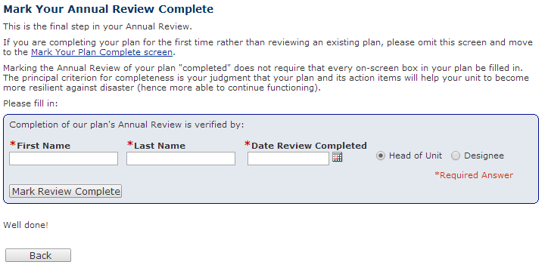
Sign-Off

Slide 38
Annual Continuity Plan Testing
Self-guided scenario, discuss the disruption that would challenge your critical functions
Gather personnel to discuss the viability of the plan
Make any necessary updates and revisions
Distribute to department personnel
Requirement by Internal Audit & Management Advisory Services

Slide 39
Questions?
The only thing harder than planning for an emergency is explaining why you didn’t.

Slide 40
Continuity Planning for East Carolina University
L a u r e n G u n t e r
Continuity / Emergency Planner
Environmental Health & Safety
g u n t e r a @ e c u . e d u
328-6166
ECU Ready
a continuity planning tool for ECU

