Slide 1
Occupational Exposure to Nitrous Oxide
Presented by the ECU Office of Environmental Health and Safety

Slide 2
Uses of Nitrous Oxide
Anesthetic agent in medical, dental, and veterinary operatories
Food processing propellant
Component of certain rocket fuels
Oxidant for organic compounds
Nitrating agent for alkali metals, etc.

Slide 3
Chemical Description
A colorless gas stored as a liquid
Synonyms: laughing gas, factitious air, nitrogen oxide, dinitrogen monoxide
Chemical formula: N₂O
Clear, colorless gas at room temperature
Slightly sweet odor and taste

Slide 4
Routes of Exposure
Exposure to nitrous oxide occurs primarily through inhalation.
Skin exposure to liquefied gas may occur when handling compressed gas cylinders. This is a result of the rapid evaporation of the liquefied gas.

Slide 5
Health Effects
Breathing Nitrous Oxide can irritate the eyes, nose and throat causing coughing and/or shortness of breath.
Acute: dizziness, slurred speech, difficulty breathing, headache, nausea, fatigue, irritability
Chronic: tingling and numbness; difficulty concentrating; interference with gait; reproductive effects; neurologic, renal, and kidney disease
Pure nitrous oxide will result in asphyxiation.
Cryonic burns (or frostbite) may occur when handling compressed gas cylinder.

Slide 6
How EH&S Monitors Exposure
An Assay Technology ChemDisk monitor for nitrous oxide is worn for the duration of the procedure on the lapel to represent the breathing zone.
The disk is collected and sent to an AIHA accredited laboratory for testing.
A report of the results is
distributed to the supervisor and the employee.

Slide 7
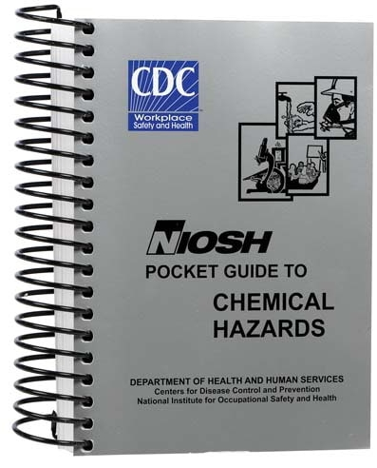
Employee Exposure to Nitrous Oxide
OSHA does not regulate nitrous oxide exposure.
NIOSH Recommended Exposure Limit (REL) 25ppm
ACGIH Threshold Limit Value (TLV): 50 ppm as a TWA
EH&S compares your exposure to the ACGIH TLV.

Slide 8
ACGIH TLV TWA
ACGIH Threshold Limit Value is the average concentration for a normal 8-hour workday and a 40-hour workweek to which nearly all workers may be exposed repeatedly, day after day, without adverse effects.

Slide 9
When Will Monitoring Take Place?
Exposure monitoring is the first step to measure nitrous oxide and determine the type and extent of controls that are necessary. Such monitoring include:
Initial monitoring
Annual monitoring
Periodic monitoring when initial results are above the TLV or there is a change in the procedure.

Slide 10
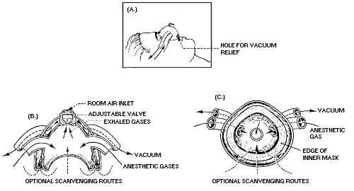
Protective Work Clothing and Equipment
Scavenging system provides adequate respiratory protection when operating within design specifications.
Thermal resistant gloves are necessary when handling compressed gas cylinders, as this may present a cryogenic hazard.

Slide 11
Leaks
Stop the leak (shut off cylinder) if it is possible to do so without risk.
Provide additional ventilation to the area.
Isolate the area until gas has dispersed.

Slide 12
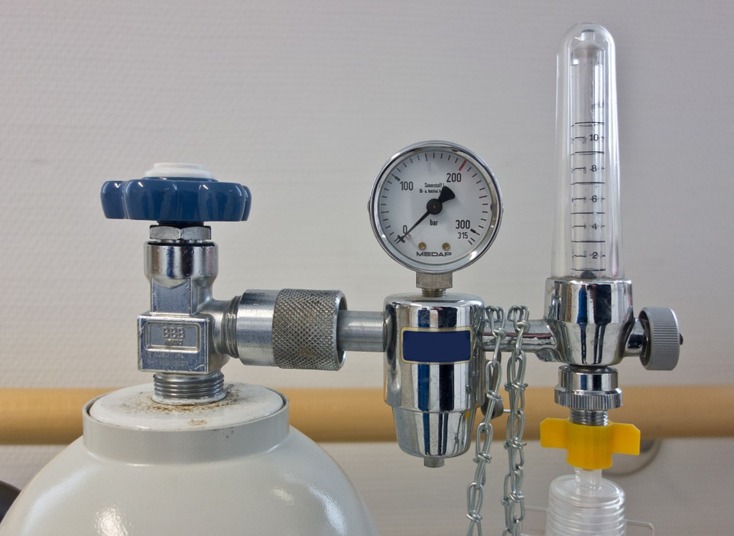
Storage
Cylinders should be secured with straps or chains to prevent physical damage.
For additional storage information, visit
www.ecu.edu/oehs/LabSafety/compressed.htm

Slide 13
Control Measures for Anesthetic Delivery System
Check all rubber hoses, connections, tubing, and breathing bags.
Check both high and low pressure connections.
Check nitrous oxide and oxygen mixing system.
Perform leak testing of the equipment.

Slide 14
Control Measures for Scavenging System
Assure that the nitrous oxide is turned on only if the scavenging system is also activated.

Slide 15
Control Measures for Scavenging System
To prevent significant leakage, scavenging system exhaust rates should be approximately 45 L/min,cegardless of the number of systems operating at a time.
Monitor flow rate with a
flowmeter.

Slide 16
Control Measures for Scavenging System
Supply scavenging mask in a variety of sizes to ensure a secure fit over the patients nose or face.
All scavenging pumps should vent to the outside of the building away from fresh
air intakes, windows, and walkways.

Slide 17
Work Practices to Control Exposure
Do not fill the breathing bag to capacity with nitrous oxide.
Minimize speech and mouth breathing by the patient during the procedure.
After the procedure, flush the system of nitrous oxide.

Slide 18
Questions
To receive credit for this training please complete the linked
QUIZ
211 South Jarvis Street, Suite 102, Greenville NC 27858
Online: www.ecu.edu/oehs
Email: safety@ecu.edu
Phone: (252) 328-6166

