Slide 1


Respiratory Protection Standard
29 CFR 1910.134

Slide 2
Introduction
Wearing respiratory protective devices to reduce exposure to airborne contaminants is widespread in industry.
An estimated 5.0 million workers wear respirators, either occasionally or routinely. Although it is preferred industrial hygiene practice to use engineering controls to reduce contaminant emissions at their source, there are operations where this type of control is not technologically or economically feasible or is otherwise inappropriate.
Notes:
Exposure to a concentration of an airborne contaminant that would occur if the employee were not using respiratory protection.

Slide 3
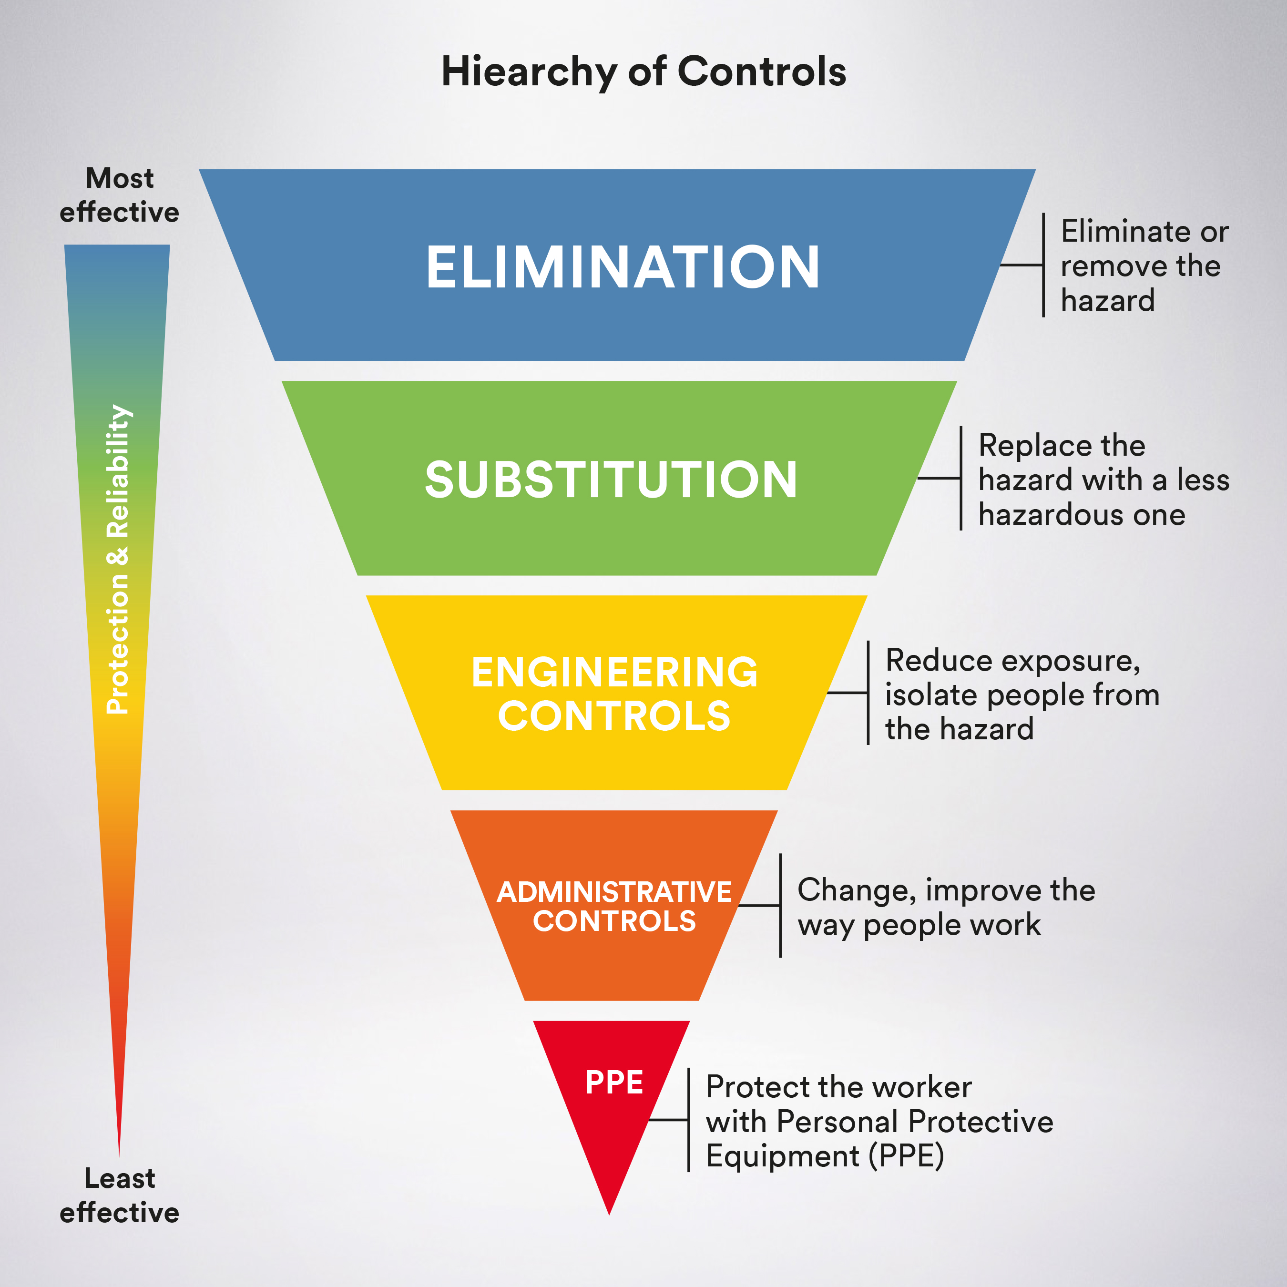

Slide 4
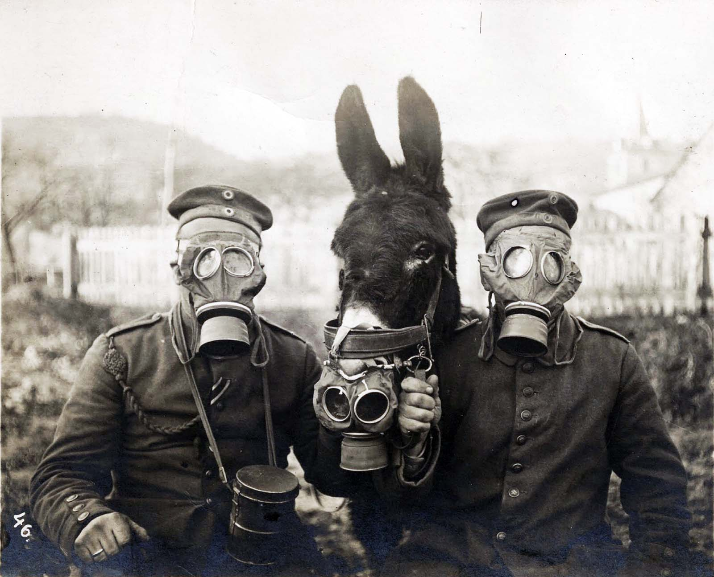
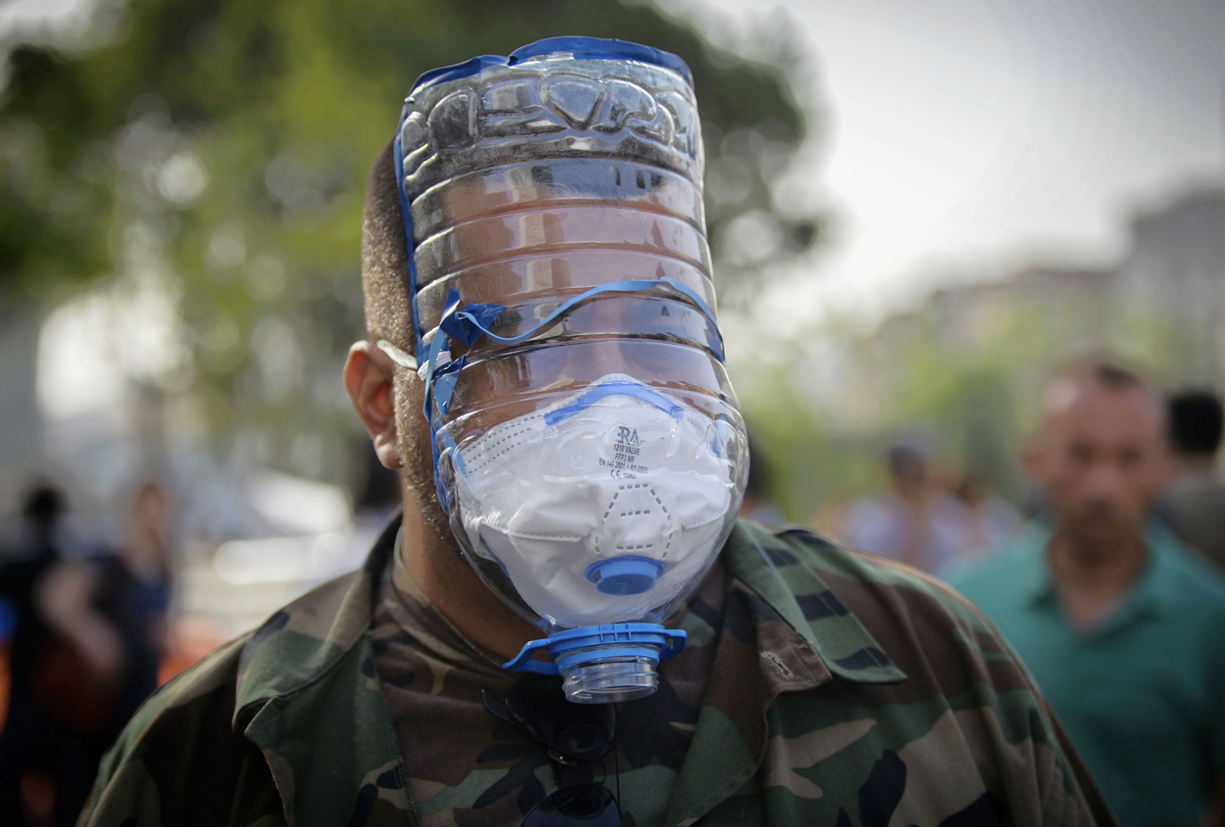
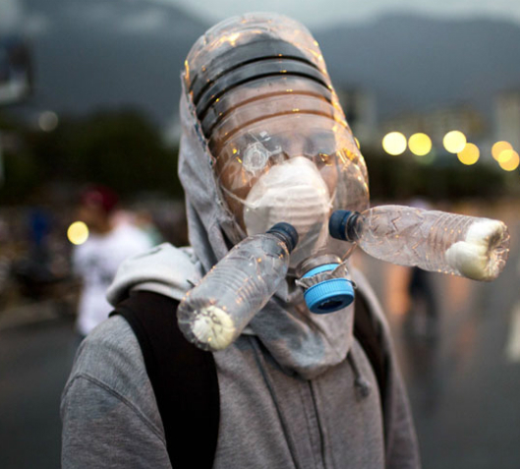
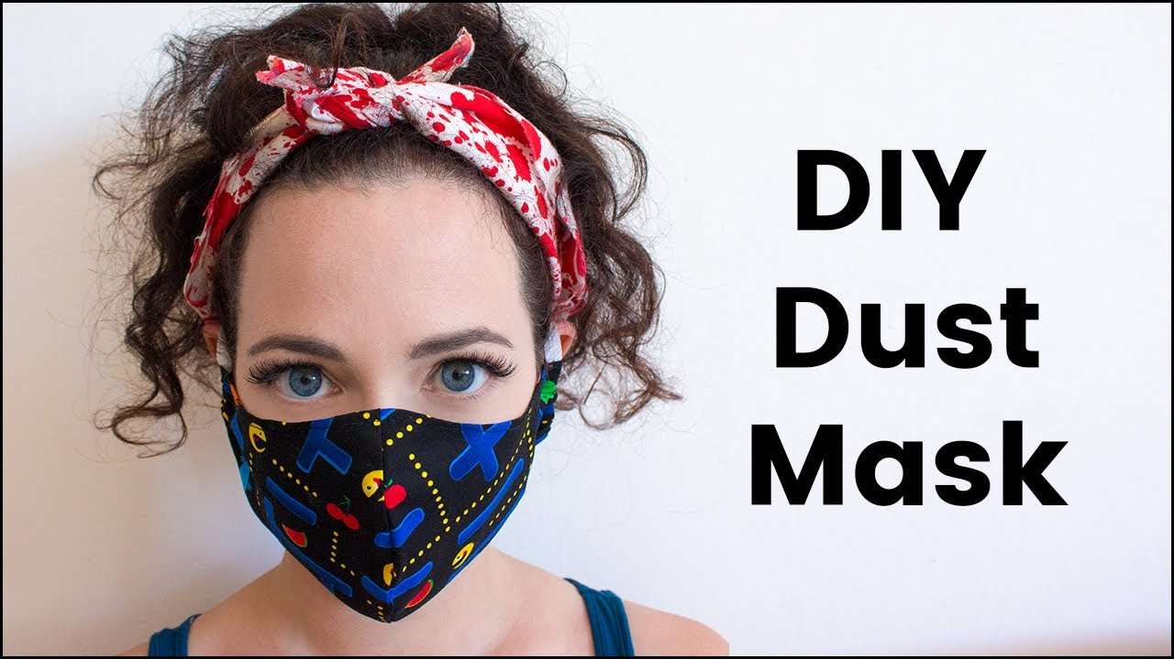
The Evolution of Respirators

Slide 5
Training Overview
(a) Permissible practice
(b) Definitions
(c) Respirator program
(d) Selection of respirators
(e) Medical evaluation
(f) Fit testing
(g) Use of respirators
(h) Maintenance and care
(i) Training and information

Slide 6
Permissible Practice
The primary means to control occupational diseases caused by breathing contaminated air is through the use of feasible engineering controls, such as enclosures, confinement of operations, ventilation, or substitution of less toxic materials
When effective engineering controls are not feasible, or while they are being instituted, appropriate respirators shall be used pursuant to this standard
Employer shall provide respirators, when necessary, which are applicable and suitable for the purpose intended
Employer shall be responsible for establishment and maintenance of a respirator program which includes the requirements of paragraph (c), Respiratory protection program
Notes:
Exposure to a concentration of an airborne contaminant that would occur if the employee were not using respiratory protection.

Slide 7
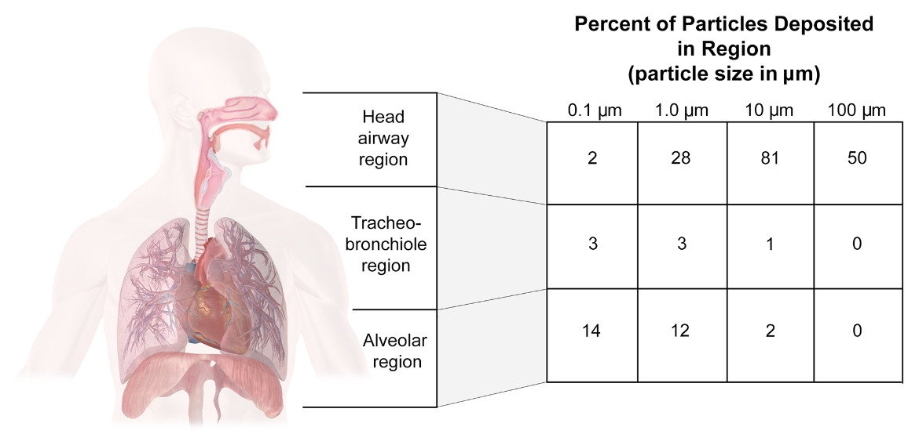
Hazard Assessment

Slide 8
Tight -Fitting Coverings
Quarter Mask
Half Mask
Full Facepiece
Mouthpiece/Nose Clamp
(no fit test required)

Slide 9
Loose-Fitting Coverings
Hood
Helmet
Loose-Fitting
Facepiece
Full Body Suit

Slide 10
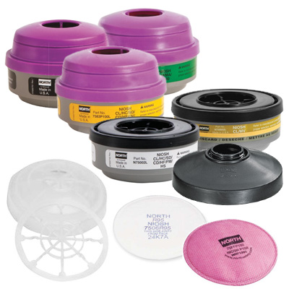
Filter, Canister or Cartridge
Filter: A component used in respirators to remove solid or liquid aerosols from the inspired air. Also called air purifying element.
Canister: A container with a filter, sorbent, or catalyst, or combination of these items, which removes specific contaminants from the air passed through the container.

Slide 11
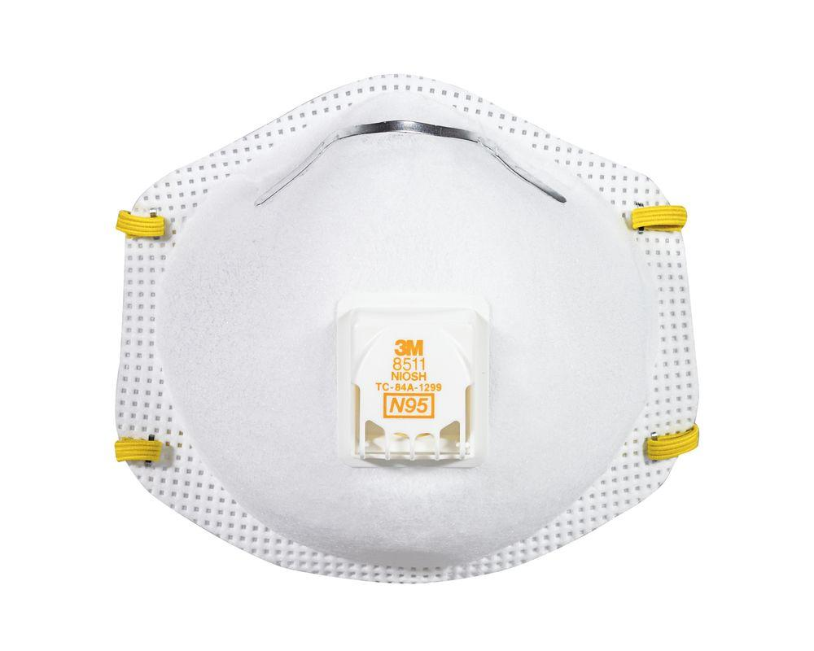
Negative & Positive Pressure Respirators
A respirator in which the air pressure inside the facepiece is negative during inhalation with respect to the ambient air pressure outside the respirator. An example is the N95 filtering facepiece (dust mask).
A positive pressure respirator is one in which the pressure inside the respiratory inlet covering exceeds the ambient air pressure outside the respirator. An example is the Powered air purifying respirators (PAPR)

Slide 12
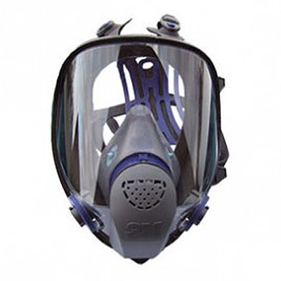
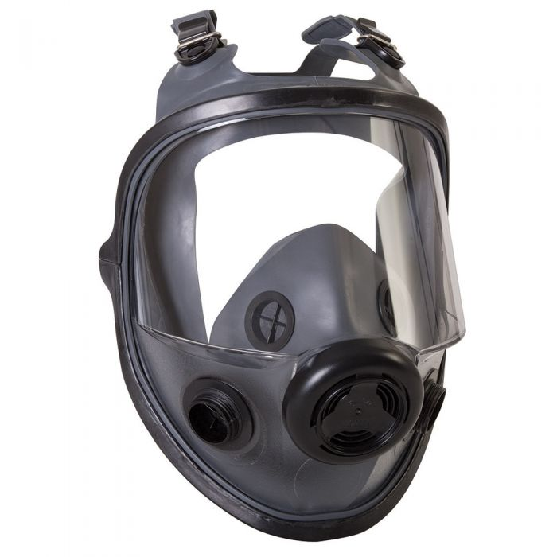
Air-Purifying Respirator (APR)
These respirators do not supply oxygen and therefore cannot be used in an oxygen-deficient or IDLH environment. They work by removing contaminants from the air through the use of filters, cartridges, or canisters. They are grouped into three general types: particulate removing, vapor and gas removing, and combination. Elements that remove particulates are called filters, while vapor and gas removing elements are called either chemical cartridges or canisters

Slide 13
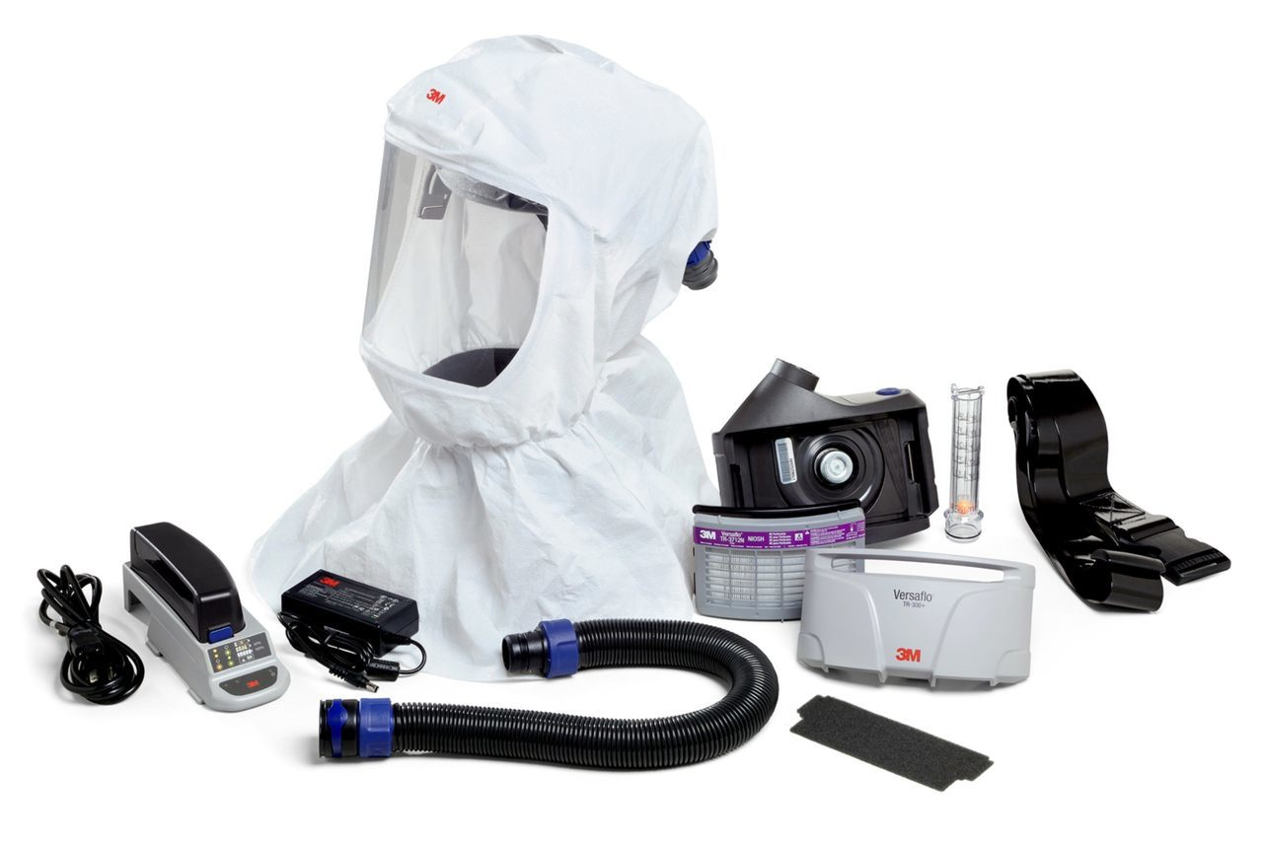
Powered Air-Purifying Respirator (PAPR)
An air-purifying respirator that uses a blower to force the ambient air through air-purifying elements to the inlet covering.

Slide 14
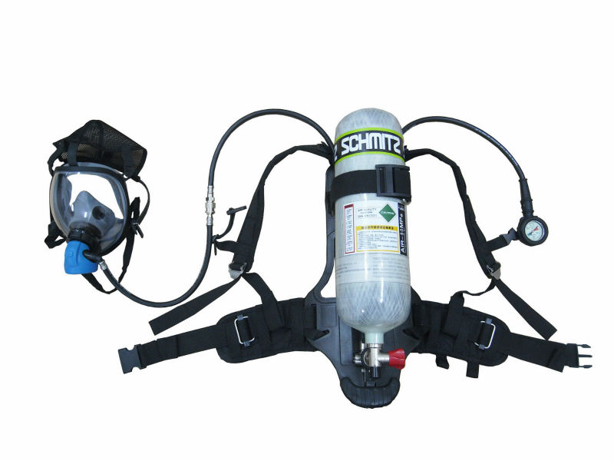
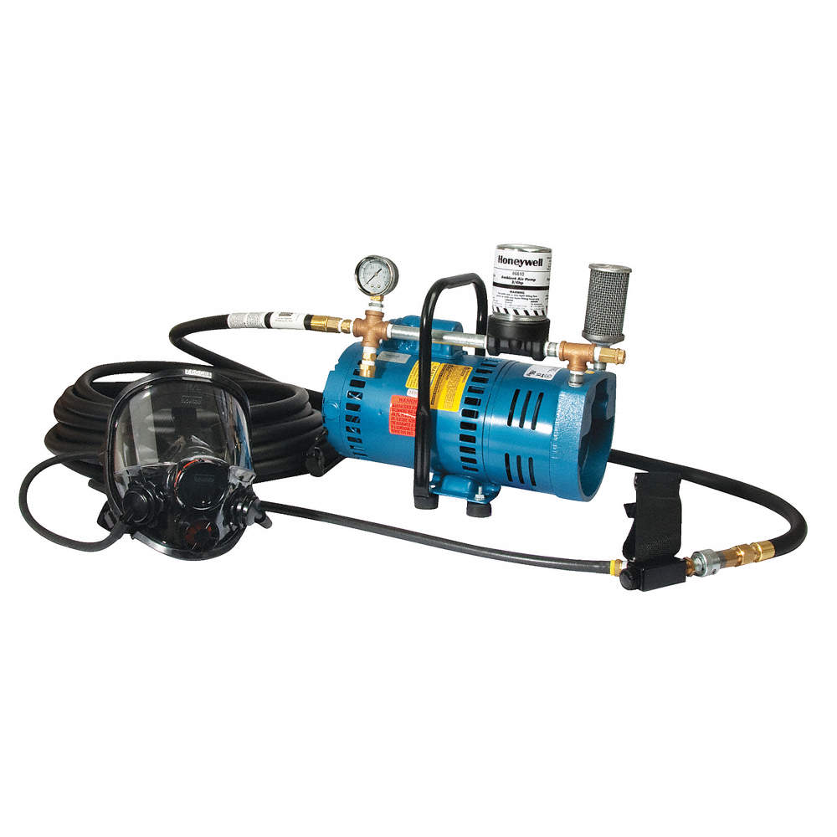
Atmosphere-Supplying Respirator
A respirator that supplies the user with breathing air from a source independent of the ambient atmosphere
Includes supplied-air respirators (SARs) and self-contained breathing apparatus (SCBA) units

Slide 15
Classes of Atmosphere-
Supplying Respirators
Continuous Flow. Provides a continuous flow of breathing air to the respiratory inlet covering
Demand. Admits breathing air to the facepiece only when a negative pressure is created inside the facepiece by inhalation
Pressure Demand. Admits breathing air to the facepiece when the positive pressure inside the facepiece is reduced by inhalation

Slide 16
Respirator Program Elements
OSHA requires the development of a written program with worksite-specific procedures when respirators are necessary or required by the employer
Written Operating Procedures
Proper Selection
Training and Fit Testing
Storage
Inspection and Maintenance
Work Area Surveillance

Slide 17
Selection of Respirators
Select a NIOSH-certified respirator that shall be used in compliance with the conditions of its certification
Identify and evaluate the respiratory hazards in the workplace, including a reasonable estimate of employee exposures and identification of the contaminant’s chemical state and physical form
Where exposure cannot be identified or reasonably estimated, the atmosphere shall be considered Immediately Dangerous to Life or Health (IDLH)
Select respirators from a sufficient number of models and sizes so that the respirator is acceptable to, and correctly fits, the user

Slide 18
Assigned Protection Factors (APF)
Must use the APF’s listed in Table 1 to select a respirator that meets or exceeds the required level of protection
When using a combination respirator (e.g., airline with an air-purifying filter), must ensure that the APF is appropriate to the mode of operation in which the respirator is being used
Notes:
Must use the APF’s listed in Table 1 to select a respirator that meets or exceeds the required level of protection
When using a combination respirator (e.g., airline with an air-purifying filter), must ensure that the APF is appropriate to the mode of operation in which the respirator is being used

Slide 19
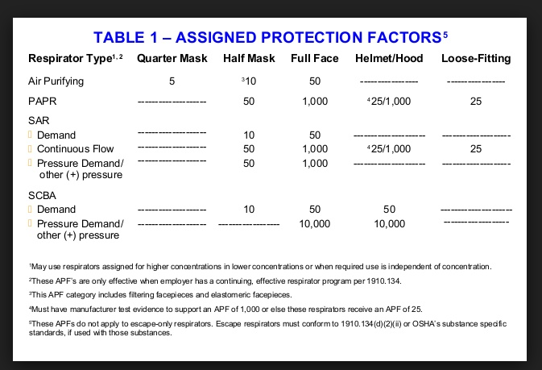
Notes:
Must use the APF’s listed in Table 1 to select a respirator that meets or exceeds the required level of protection
When using a combination respirator (e.g., airline with an air-purifying filter), must ensure that the APF is appropriate to the mode of operation in which the respirator is being used

Slide 20
Maximum Use Concentration (MUC)
The maximum atmospheric concentration of a hazardous substance from which an employee can be expected to be protected when wearing a respirator, and is determined by the assigned protection factor of the respirator or class of respirators and the exposure limit of the hazardous substance
MUC = APF x OSHA Exposure Limit¹
¹ When no OSHA exposure limit is available for a hazardous substance, the employer must determine an MUC on the basis of relevant available information and informed professional judgment.
Notes:
Must use the APF’s listed in Table 1 to select a respirator that meets or exceeds the required level of protection
When using a combination respirator (e.g., airline with an air-purifying filter), must ensure that the APF is appropriate to the mode of operation in which the respirator is being used

Slide 21
End-of-Service-Life Indicator (ESLI)
When an air-purifying respirator is selected for protection against gases and vapors, a system must be in effect that will reliably warn respirator wearers of contaminant breakthrough. These systems are: a respirator equipped with an end-of-service life indicator (ESLI) certified by NIOSH for the contaminant, or an established and enforced cartridge/canister change schedule that is based on objective information or data that will ensure that canisters and cartridges are changed before the end of their service life.
Notes:
Must use the APF’s listed in Table 1 to select a respirator that meets or exceeds the required level of protection
When using a combination respirator (e.g., airline with an air-purifying filter), must ensure that the APF is appropriate to the mode of operation in which the respirator is being used

Slide 22
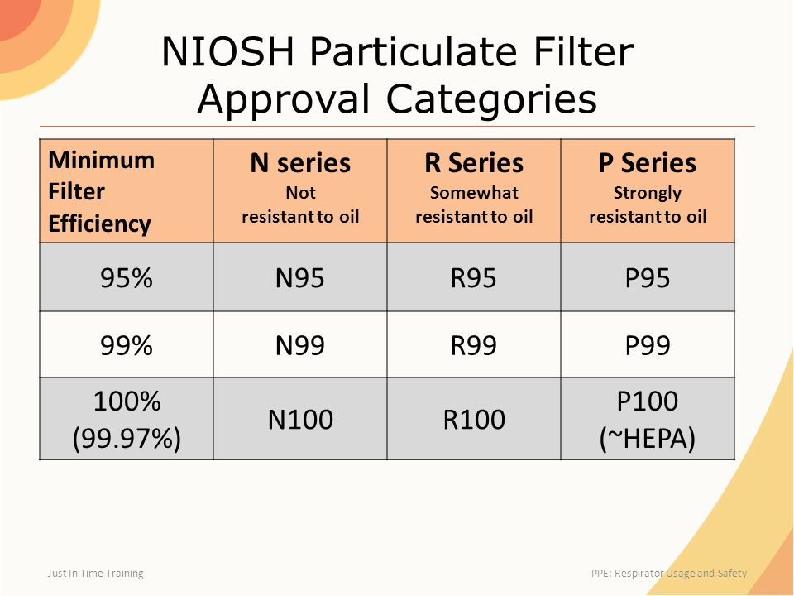
Classes of Nonpowered Air-Purifying Particulate Filters
Notes:
Must use the APF’s listed in Table 1 to select a respirator that meets or exceeds the required level of protection
When using a combination respirator (e.g., airline with an air-purifying filter), must ensure that the APF is appropriate to the mode of operation in which the respirator is being used

Slide 23
Medical Evaluation
Employees must be medically evaluated and found eligible to wear the respirator selected for their use prior to fit testing or first-time use of the respirator in the workplace. Medical eligibility is to be determined by a physician or other licensed health care professional (referred to as a "PLHCP"). A variety of qualified health care providers, besides physicians, including occupational health nurses, nurse practitioners, and physician assistants, can perform the medical evaluations provided they are licensed to do so in the state in which they practice.
Notes:
Must use the APF’s listed in Table 1 to select a respirator that meets or exceeds the required level of protection
When using a combination respirator (e.g., airline with an air-purifying filter), must ensure that the APF is appropriate to the mode of operation in which the respirator is being used

Slide 24
Respirator Fit Test
Before an employee uses any respirator with a negative or positive pressure tight-fitting facepiece, the employee must be fit tested with the same make, model, style, and size of respirator that will be used.
Notes:
Must use the APF’s listed in Table 1 to select a respirator that meets or exceeds the required level of protection
When using a combination respirator (e.g., airline with an air-purifying filter), must ensure that the APF is appropriate to the mode of operation in which the respirator is being used

Slide 25
User Seal Check
An action conducted by the respirator user to determine if the respirator is properly seated to the face.
Positive Pressure Check
Negative Pressure Check
Notes:
Must use the APF’s listed in Table 1 to select a respirator that meets or exceeds the required level of protection
When using a combination respirator (e.g., airline with an air-purifying filter), must ensure that the APF is appropriate to the mode of operation in which the respirator is being used

Slide 26
Maintenance and Care
The OSHA standard requires that each user is issued a respirator that is clean, sanitary, and in good working order. It also requires that a maintenance program be developed prior to use of respirator to ensure the respirators remain serviceable and delivers effective protection
The OSHA respirator standard strongly emphasizes the importance of a good maintenance program that is specific to the type of facilities, working conditions, and hazards involved. The programs are required to include at least:
Cleaning and disinfecting procedures;
Proper storage;
Regular inspections for defects (including leak check); and
Repair methods.
Notes:
Must use the APF’s listed in Table 1 to select a respirator that meets or exceeds the required level of protection
When using a combination respirator (e.g., airline with an air-purifying filter), must ensure that the APF is appropriate to the mode of operation in which the respirator is being used

Slide 27
Training and Information
Employee training is an important part of the respiratory protection program and is essential for correct respirator use. The OSHA respiratory protection standard requires employers to provide training before the employee uses a respirator in the workplace. For the training to be effective, the training information must be comprehensive and presented in an understandable way.
Notes:
Must use the APF’s listed in Table 1 to select a respirator that meets or exceeds the required level of protection
When using a combination respirator (e.g., airline with an air-purifying filter), must ensure that the APF is appropriate to the mode of operation in which the respirator is being used

Slide 28

Des Questions/Preguntas

Slide 29

Quiz: Specific (Required)
Start Your Quiz
Questions
211 South Jarvis Street, Suite 102, Greenville NC 27858
Online: www.ecu.edu/oehs
Email: safety@ecu.edu
Phone: (252) 328-6166

Slide 30
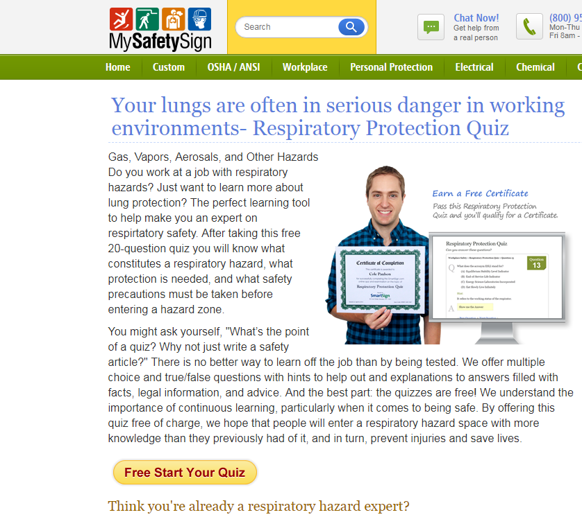
Quiz: Knowledge Booster (Optional)
Start Your Quiz

