Slide 1


Confined Space Entry

Slide 2
Training
Employee proficiency in safe performance of entry duties
Upon initial assignment
Change in assigned duties or a change in permit space conditions
Inadequacies in the employee's knowledge or use of confined space entry procedures

Slide 3
Training Outline
Introduction
General Requirements
Equipment Requirements
The Entry Permit
Duties of Authorized Entrants, Attendants and Entry Supervisor
Rescue and Emergency Services
Contractors
Safe Entry Procedures

Slide 4
Introduction
OSHA 29 CFR 1910.146: Permit-Required Confined Spaces
Ensure that employees can safely enter and work in permit-required spaces

Slide 5
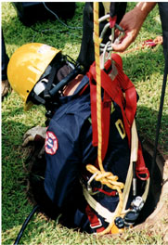
Introduction
A confined space:
Is large enough that an employee can enter and work
Has limited or restricted means for entry or exit
Is not designed for continuous occupancy

Slide 6
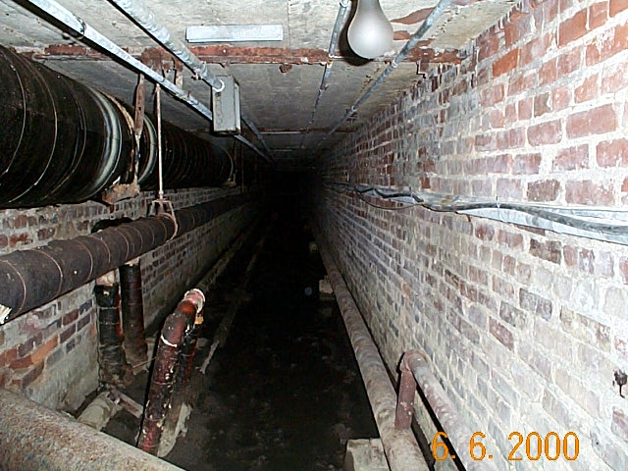
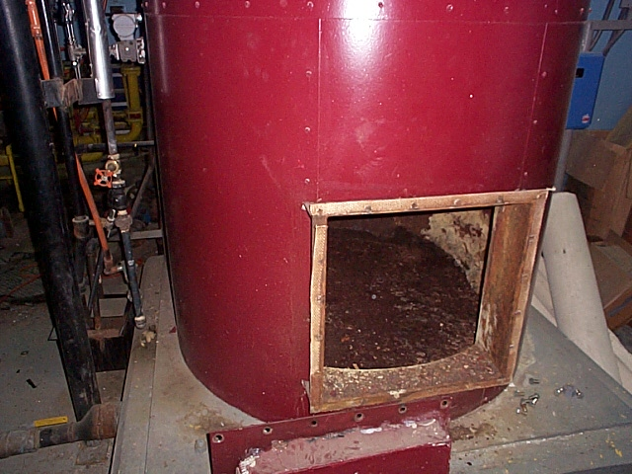
Introduction
Examples:
tanks
pits
tunnels
vaults
boilers
sewers
shafts
ventilation ducts
crawl spaces

Slide 7
Introduction
A permit-required confined space:
Contains or has the potential to contain a hazardous atmosphere
Contains a material that has the potential for engulfing an entrant
Internal configuration that might trap or asphyxiate entrant by inwardly converging walls or floor that slopes downward and tapers to a smaller cross section
Contains any other recognized serious safety or health hazard

Slide 8
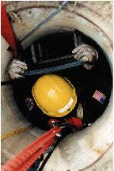
Introduction
"Entry" – passing through an opening into a confined space
Any part of the entrant's body breaks the plane of the opening

Slide 9
General Requirements
Identify confined spaces and classify as permit or non-permit
A permit-required confined space may be reclassified
Identify and evaluate the hazards of the permit spaces before employees enter
Inform exposed employees of location of permit space and associated hazards

Slide 10
General Requirements
Measures to prevent entry
Develop and implement practices and procedures for safe entry
Provide and maintain all required equipment
Educate employees on safe entry procedures and equipment operation

Slide 11
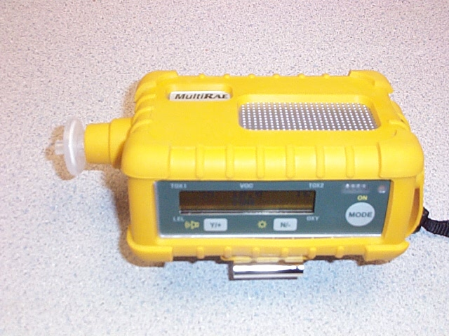
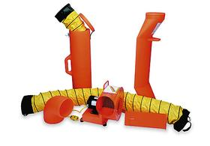
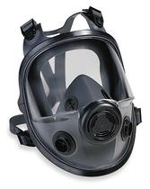
Equipment Requirements
Testing and monitoring equipment
Ventilation equipment
Communication equipment
PPE
Lighting equipment
Barriers and shields
Equipment for safe ingress and egress
Emergency equipment
Other equipment

Slide 12

The Entry Permit
Permit must be completed before entry is authorized
Entry supervisor must sign the permit
Permit must be available so entrants can confirm that pre-entry items are completed

Slide 13
The Entry Permit
Duration may not exceed the time identified on the permit
Retain each canceled permit for at least 1 year for review of the program
Problems encountered during entry are noted on the permit so appropriate revisions can be made to the program

Slide 14
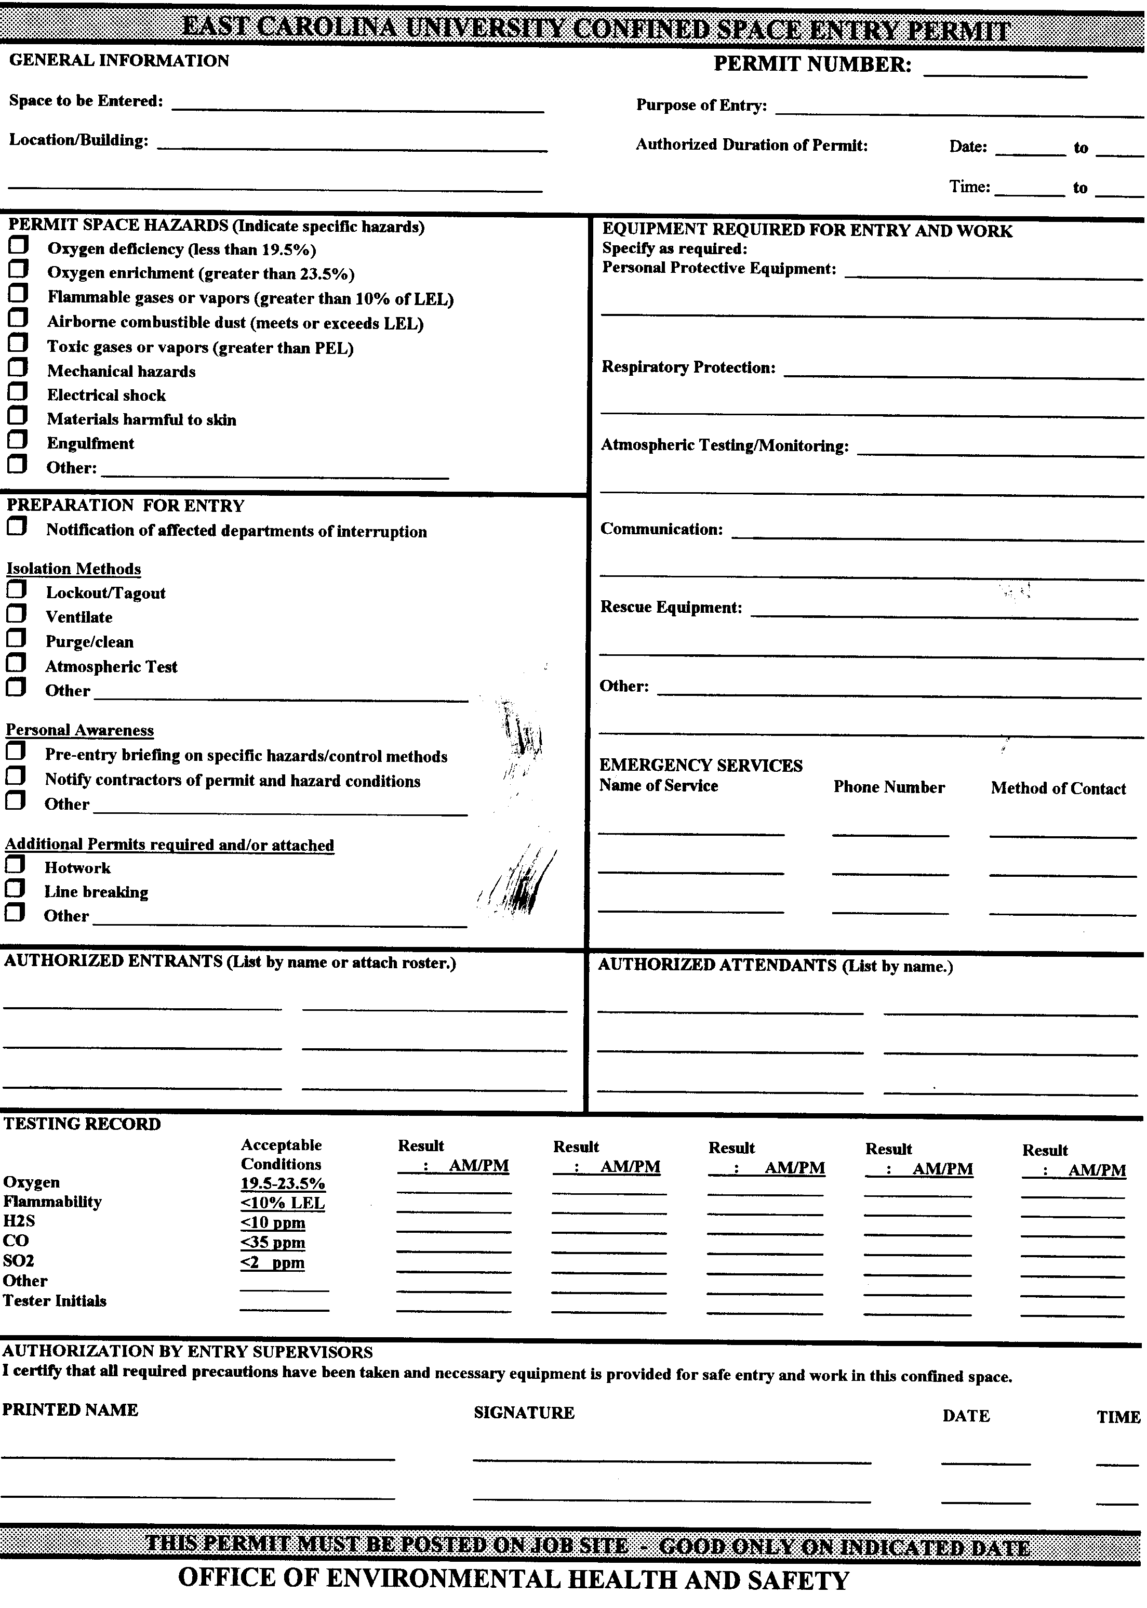

Slide 15
Contents of Permit
Permit space to be entered
Purpose of the entry
Date and the authorized duration of the entry permit
Authorized entrants
Attendants
Entry supervisor with a space for the signature

Slide 16
Contents of Permit
Hazards of the permit space
Measures used to isolate the permit space and to eliminate or control permit space hazards before entry
Acceptable entry conditions
Results of initial and periodic tests, names or initials of the testers and when the tests were performed

Slide 17
Contents of Permit
Rescue and emergency services
Communication procedures
Equipment (personal protective equipment, testing equipment, communications equipment, alarm systems, rescue equipment, etc.)
Any other information necessary to ensure employee safety

Slide 18
Duties of Authorized Entrants
"Authorized entrant" - authorized by the employer to enter space
Know the hazards including signs, symptoms, and consequences of exposure
Properly use equipment
Communicate with the attendant so attendant can monitor entrant status and alert entrants of the need to evacuate

Slide 19
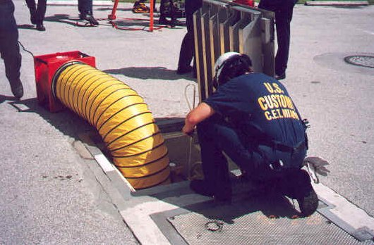
Duties of Authorized Entrants
Alert the attendant whenever:
Entrant recognizes warning sign or symptom of exposure to a dangerous situation
The entrant detects a prohibited condition

Slide 20
Duties of Authorized Entrants
Evacuate the confined space when:
Order to evacuate is given by the attendant or the entry supervisor
Entrant recognizes any warning sign or symptom of exposure to a dangerous situation
Entrant detects a prohibited condition
Evacuation alarm is activated

Slide 21
Duties of Attendants
"Attendant" - stationed outside permit space; monitors entrants
Knows the hazards including signs, symptoms and consequences of exposure
Continuously maintains accurate count of entrants in permit space
Remains outside the permit space during entry until relieved by another attendant

Slide 22

Duties of Attendants
Communicates with entrants to monitor entrant status and to alert entrants of the need to evacuate
Monitors activities inside & outside the space to determine if it is safe for entrants to remain in the space

Slide 23
Duties of Attendants
Orders evacuation immediately:
Detects a prohibited condition
Detects the behavioral effects of hazard exposure in entrant
Detects a situation outside the space that could endanger the entrants
If the attendant cannot effectively and safely perform all the duties

Slide 24
Duties of Attendants
Summon emergency services
Keep unauthorized persons away
Performs non-entry rescues when applicable and only if they have training/equipment
Performs no duties that might interfere with primary duty to monitor and protect entrants

Slide 25
Duties of Entry Supervisor
"Entry supervisor" - person responsible for determining if acceptable entry conditions are present, for authorizing entry, overseeing entry operations, and for terminating entry as required
An entry supervisor also may serve as an attendant or as an entrant

Slide 26
Duties of Entry Supervisor
Knows the hazards including signs, symptoms, and consequences of the exposure
Verifies that the entry permit is complete, all tests have been conducted and all procedures and equipment are in place before entry
Verifies that rescue services are available and that the means for summoning them are operable

Slide 27
Duties of Entry Supervisor
Removes unauthorized individuals who enter/attempt to enter space
Ensures acceptable entry conditions are maintained throughout the entry
Terminates entry and cancels permit when the operations have been completed or a condition that is not allowed under the permit arises

Slide 28
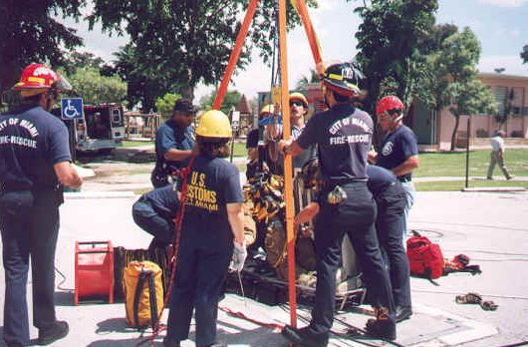
Rescue and Emergency Services
Self-Rescue
Non-entry Rescue
Only trained and equipped workers can enter space
Replacement attendant
Greenville Fire/Rescue
Call 911

Slide 29
Rescue and Emergency Services
Responds in a timely manner
Rescue provider must be proficient with confined space rescue-related tasks/equipment
Inform rescue provider of the hazards they may encounter
Provide the rescue provider with access to all permit spaces so they can develop rescue plans and practice rescue operations

Slide 30
Rescue and Emergency Services
Retrieval systems shall be used unless they increase the overall risk of entry or would not contribute to the rescue
Each entrant shall use a full body harness and a retrieval line if feasible
The other end of the retrieval line shall be attached to a mechanical device or fixed point outside the permit space
A mechanical retrieval device shall be available for vertical type permit spaces more than 5 feet deep

Slide 31
Contractors
Inform contractor that workplace contains permit spaces and entry is allowed only in compliance with permit space program
Apprise contractor of the hazards in the permit space
Apprise contractor of precautions for the protection of employees in or near permit spaces where contractor will be working

Slide 32
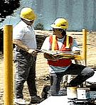
Contractors
Coordinate with contractor when both host and contractor will be working in or near the permit spaces
Debrief contractor at the conclusion of entry
Contractor shall inform the host of the permit program that they will follow and any hazards confronted or created

Slide 33
Safe Entry Procedures
Perform work outside of space?
Contact EH&S at least 1 week in advance to schedule entry and obtain permit
Designate entrants, attendants, entry supervisors and atmospheric monitors, identify the duties of each, and assure training has been provided
Notify all departments affected by entry
Post signs and barriers to protect entrants from traffic and pedestrians
Specify acceptable entry conditions

Slide 34
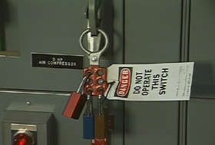
Safe Entry Procedures
Ventilate, eliminate, or control the space’s atmospheric hazards before entry
Blind or disconnect and cap all input lines so that no hazardous materials can enter the space
Lockout/Tagout
When entrance covers are removed, guard the opening immediately

Slide 35
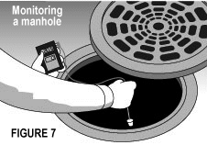
Safe Entry Procedures
Test permit space before entry begins
Monitor permit space to ensure entry conditions are maintained
Test for oxygen, flammability and toxins in that order
Observe status of other existing hazards and those created during entry

Slide 36
Safe Entry Procedures
Authorized entrants can enter a permit space only after it’s been tested and found safe for entry
The entrant must know what equipment to use & how to use it
Provide at least one attendant outside the permit space for the duration of entry

Slide 37
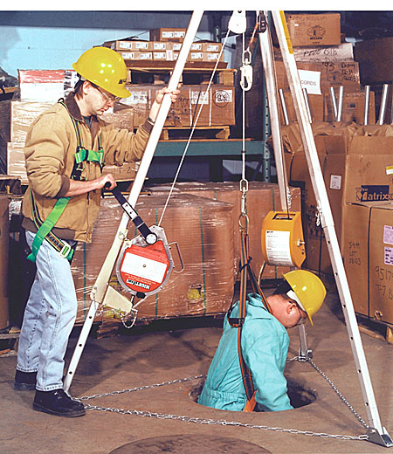
Safe Entry Procedures
Maintain acceptable conditions for duration of entry
Implement rescue and emergency procedures if necessary
Implement procedures for concluding the entry

Slide 38
Safe Entry Procedures
Review entry operations when there is reason to believe that measures taken may not protect employees and revise program before subsequent entries
Review the permit space program within 1 year after each entry and revise program as necessary to ensure employees participating in entry operations are protected

Slide 39
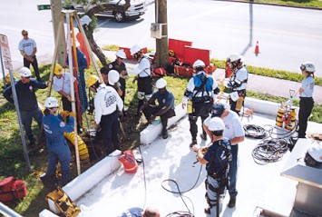
Confined Space Entry
QUESTIONS?

Slide 40

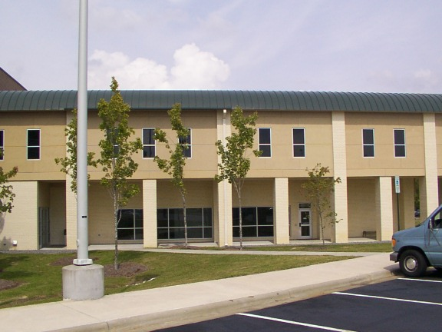
Safety and Environmental Compliance at ECU
Environmental Health & Safety Prospective Health
211 South Jarvis St. Suite 102 Warren Life Sciences
328-6166 816-2070
EH&S Administration Radiation Safety
Industrial Hygiene & Safety Biological Safety
Environmental Management Infection Control
Workers’ Compensation Employee Health

Slide 41

EH&S Web Page

